Slide 1
CESM
Creating and Using Variable Resolution Grids
AMWG Winter Meeting
Contributors:
Paul Ulrich, Colin Zarzycki, The CSEG team,
Patrick Callaghan, Adam Herrington,
Julio Bacmeister, Peter Lauritzen,
Louisa Emmons, Duseong Jo
The continuing development of VR tools is supported by NSF CAM7 funding
NSF Award ID 1755088
Feb 11, 2022
Notes:
NOTE: Background image can be used as is or changed for a particular presentation in the “Slide Master” button found under the “View” tab.

Slide 2
Some Preliminaries:
The NUOPC Era has Begun!
The MCT / CESM 2.2 Era:
Since the initial creation of the VRM_tools GitHub repository, the scripts and program have been stable for the CESM 2.2 release and newer tags.
Only some minor revisions have been needed.
The NUOPC Era:
CESM has recently transitioned from MCT to NUOPC.
As of Feb 9 2022, the VRM_tools have been revised to work for CESM tags cesm2_3_alpha08a and newer.
Everything presented today is based on this version.
This will lead to a bit more complexity for users who need to maintain VR grids for both older and current CESM tags. More about that at the end...
Users that still use older MCT tags need to checkout the ‘VRMtools_MCT_v1.0’ tag
Cheyenne% mkdir Community_Mesh_Generation_Toolkit
Cheyenne% git clone https://GitHub.com/ESMCI/Community_Mesh_Generation_Toolkit.git
Cheyenne% cd Community_Mesh_Generation_Toolkit
Cheyenne% git checkout VRMtools_MCT_v1.0
Then follow the Documentation in:
VRM_tools/Docs/AMWG_FEB21_DEMO_FILES/
AMWG Winter Meeting 2022

Slide 3
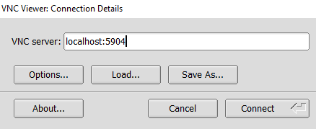
VRM editor on Linux machine (casper) using remote desktop (VNC)
Some Preliminaries:
VRM_tools updated (on Jan 11)
Update your VRM_Editor source from the GitHub repository and re-compile for the new editing options.
VRM editor gets slow via SSH shell, so you may want to VNC to use VRM editor.
On Cheyenne or Casper SSH shell,
>> vncmgr create --account PROJECT --time 12:00:00 --job-opts="-l select=1:ncpus=4:mem=20GB"
Open command prompt, and follow instructions given on the SSH shell. Start by typing the command on the command prompt something like:
>> ssh -l USERID -L 5904:localhost4:5904 casper15.ucar.edu "bash ~/.vncmgr/tunnel-default”
Load a VNC viewer on your local machine (e.g. TigerVNC or TurboVNC) and connect to the host:
More details on: https://arc.ucar.edu/knowledge_base/72581380
AMWG Winter Meeting 2022

Slide 4
Some Preliminaries:
New Features:
Changing Resolution of the Refinement Map:
Gen_REFMAP.ncl An NCL program that creates an empty (val=0) refinement map at a given resolution. Reading this map into the VRM_Editor will cause it to adjust and use the new resolution.
New VRM_Editor options for the Polygon and Rectangle Editors:
Fill All: Fill the region with the given value
Fill MaxVal: Fill the region with MAX[ given value, existing refmap value].
Fill MinVal: Fill the region with MIN[ given value, existing refmap value].
Manual Editing With VRM_Editor/Create_VRMgrid:
VRM_Editor: “Write Refinement Grid” to save the discrete refinement values
Manual Edit: Use an editor (e.g. vi) to clean up grid problems
Create_VRMgrid: “--refine_cube” command line option to create the EXODUS file.
AMWG Winter Meeting 2022

Slide 5
Outline
Overview of creating and using VR grids
Creating a grid with VRM Editor, SQuadGen
Creating CESM input files
Establishing grid defaults
Maintaining your grid repository
AMWG Winter Meeting 2022

Slide 6
Overview: The Usage Scenario for VR Grids
The usage scenario for CESM 2.2 and later is that a research group will have a common repository of grid information.
This $(REPO) will contain the VRM grids relevant to their research, which supplements the supported grid resolutions in CESM.
A local repository of grids that can be readily shared by members of a research group using compatible CESM tags.
The data in $(REPO) will need to be updated periodically to keep up with CESM development, but not for every tag.
Research Group Repository
/local/repo/
Repository of Supported Data
/glade/p/…
CESM tag_01
CESM tag_02
AMWG Winter Meeting 2022

Slide 7
Overview: Adding a New Grid
Adding a New Grid To CESM: There are 5 steps to create a new grid for use in CESM model runs.
Download source code and build executables
Creating a new grid
Create a repository of grid data; mapping, domain, initial value datasets, etc…
Install new grid CESM
Establish defaults for stable model runs.
These are the steps that one goes through to get the model running.
For scientifically meaningful runs, nudged runs, or for those using CAM-Chem there is a little more work involved.
Additional Steps:
The surface state must be spun up from the initial default (from step 3 above).
Conservative emissions data must be processed for the new grid.
Nudging data must be process for the new grid
AMWG Winter Meeting 2022

Slide 8
Overview: Contents of VRM_tools
The Docs directory:
VRM_Grids_For_CAMSE.pdf
Contains the full documentation for the creation of a new grid and the associated data files.
CAM-tsteps-inic-for-newgrids_v0.pdf
Contains a guide for establishing default time step and namelist values for a new grid.
REVISIONS_and_KNOWN-ISSUES.txt
Contains information on new feature not in the existing documentation and known problems
AMWG_FEB21_DEMO_FILES
Old PPT and related files for MCT tags.
AMWG_FEB22_DEMO_FILES
This PPT and related files
The VRM_tools directory:
VRM_tools/
SQuadGen/
VRM_Editor/
VRM_ControlVolumes/
gen_ESMFmesh/
gen_mapping/
gen_domain/
gen_CLMsrfdata/
gen_CAMncdata/
gen_atmsrf/
gen_topo/
Install_grid/
VRM_Diagnostics/
Docs/
README
REQUIRED_ENV_SETTINGS
Programs to create a new grid
Obsolete
Create mapping, domain, and input datasets for the new grid
Scripts and instructions for installing a new grid in CESM
Diagnostic utils for plotting and testing a new grid
NOTE: The pre-built executable in
VRM_Editor/MAC_exe
is an older version of the editor. This executable will not be updated or maintained.
Documentation to guide users through the process
AMWG Winter Meeting 2022

Slide 9
Overview: The Demo_Files Directory
AMWG_DEMO_FEB22-NOTES
Contains the exact commands, step-by-step, used to create the files and run the example grid in the AMWG_DEMO_FEB22 directory.
Img_SAMGRID01_1.png
Img_SAMGRID01_2.png
Img_SAMGRID01_3.png
Img_SAMGRID01_4.png
The PNG files are screen shots that are referenced in the notes.
REFMAP_SAMGRID01_Z30-X21.nc
SAMGRID01_ne30x4_EXODUS.nc
The example refinement map and grid file for the South American refinement created using VRM_Editor.
TCreference.nc
An example reference file for tropical cyclone tracks in the Atlantic basin.
REFMAP_SAMGRID01_Z30.7-X22.5-HALO.nc
A variation of the South American refinement map.
The DEMO files:
There is not enough time to go thru beginning to end.
The <AMWG_DEMO_FEB22> directory contains results from the step-by-step commands in the NOTES file.
We will go thru the sequence of commands and review what is being done at each point.
Users are encouraged to follow thru the steps and reproduce the results for this example grid.
The having successfully gone thru the process once, repeat the process with their own grid.
The results in the <AMWG_DEMO_FEB22> directory can then be used as a reference if the user have and problems along the way to creating their new grid.
It is assumed that everyone has access to the glade and the NCAR compute environment. Users in other environments will need to adjust scripts to access the relevant datasets on their compute environment.
AMWG Winter Meeting 2022

Slide 10
Overview: The Users Repository
Note the naming convention for the Variable Resolution Mesh grids.
When completed, the user has generated a repository of required values for each grid, stored with the following directory structure:
ne0np4.NAME.ne30x4
/my/local/repo/
ne0np4 = all variable resolution grids with 4 GLL points must begin with this.
ne0np4.SAMGRID01.ne30x4/
ne0np4.MyOtherGrid.ne30x8/
atmsrf/
atmsrf/
NAME = unique name for your grid
domains/
domains/
grids/
grids/
ne30 = the base resolution of the unrefined grid.
x4 = The refinement factor for the highest resolution region
e.g. For a ne120 grid: 30x4 = 120.
inic/
Obsolete
inic/
maps/
maps/
topo/
topo/
clm_surfdata_5_0/
clm_surfdata_5_0/
AMWG Winter Meeting 2022

Slide 11
(1) Building Executables
====================================================================
(2) Build the pre-requisite executables
====================================================================
-------------------------------
--> Build VRM_Editor on Casper
-------------------------------
cheyenne% execcasper
casper% cd Community_Mesh_Generation_Toolkit/VRM_tools/VRM_Editor/src
casper% module load gnu/9.1.0
casper% qmake-qt5 VRM_Editor.pro
casper% make
---------------
**NOTE**:
--------------- The editor can now be run in this directory:
casper% ./VRM_Editor
* The editor is not as prone to crashing when running on Casper
but users will need to be patient with latency when using
the mouse.
* When running on the VRM_Editor on Casper, be sure to re-load
the gnu/9.1.0 module first:
casper% module list
Currently Loaded Modules:
1) ncarenv/1.3 2) gnu/9.1.0 3) ncarcompilers/0.5.0
4) netcdf/4.7.4 5) openmpi/4.0.5
Users interested in using the command line program for manual grid editing should build that executable now:
Casper% make –f Makefile-Create_VRMgrid
Run the command with no arguments to get the usage values:
Casper% ./Create_VRMgrid
AMWG_DEMO_FEB22-NOTES
In the Doc directory contains the step-by-step process outlined here.
The first section of this file goes thru the steps for checking out the tools and the cesm2_3_alpha08a tag used here.
These steps are omitted.
-------------------------------
--> VRM_Editor For Linux/Mac
-------------------------------
For Linux users, with the Qt and netCDF packages installed,
building the editor is just as simple as for Casper.
For Mac users.... not so much.
*** For details on Linux/MAC see the documentation in:
Community_Mesh_Generation_Toolkit/VRM_tools/Docs/VRM_Grids_For_CAMSE.pdf
AMWG Winter Meeting 2022

Slide 12
(1) Building Executables
-------------------------------
--> Build mksurfdata_map
-------------------------------
cheyenne% cd $(AMWG_DEMO_FEB22)/src/cesm2_2_alpha08a/components/clm/tools/mksurfdata_map/src
cheyenne% module load ncl
cheyenne% module list
Currently Loaded Modules:
1) ncarenv/1.3 2) intel/19.1.1 3) ncarcompilers/0.5.0
4) netcdf/4.8.1 5) ncl/6.6.2 6) mpt/2.22
cheyenne% setenv LIB_NETCDF $NCAR_LDFLAGS_NETCDF
cheyenne% setenv INC_NETCDF $NCAR_INC_NETCDF
cheyenne% gmake
-------------------------------
--> Build gen_domains
-------------------------------
cheyenne% cd $(AMWG_DEMO_FEB22)/src/cesm2_3_alpha08a/cime/tools/mapping/gen_domain_files/src
cheyenne% module list
Currently Loaded Modules:
1) ncarenv/1.3 2) intel/19.0.5 3) ncarcompilers/0.5.0
4) netcdf/4.7.4 5) ncl/6.6.2 6) mpt/2.22
cheyenne% ../../../configure --macros-format Makefile --mpilib mpi-serial
cheyenne% (source ./.env_mach_specific.csh ; gmake)
-------------------------------
--> Build interpic
-------------------------------
cheyenne% cd $(AMWG_DEMO_FEB22)/src/cesm2_3_alpha08a/components/cam/tools/interpic_new
cheyenne% module load ncl
cheyenne% module list
Currently Loaded Modules:
1) ncarenv/1.3 2) intel/19.1.1 3) ncarcompilers/0.5.0
4) netcdf/4.8.1 5) mpt/2.22 6) ncl/6.6.2
cheyenne% setenv LIB_NETCDF $NCAR_LDFLAGS_NETCDF
cheyenne% setenv INC_NETCDF $NCAR_INC_NETCDF
cheyenne% gmake
-------------------------------
--> Build Gen_ControlVolumes.exe
-------------------------------
cheyenne% cd $(VRM_tools)/VRM_ControlVolumes/src
cheyenne% module list {check what compiler is set}
Currently Loaded Modules:
1) ncarenv/1.3 2) intel/19.1.1 3) ncarcompilers/0.5.0
4) mpt/2.22 5) netcdf/4.8.1 6) ncl/6.6.2
cheyenne% module load gnu {switch to GNU compiler}
cheyenne% module list
Currently Loaded Modules:
1) ncarenv/1.3 2) gnu/10.1.0 3) ncarcompilers/0.5.0
4) netcdf/4.8.1 5) mpt/2.22
Inactive Modules:
1) ncl
cheyenne% make
cheyenne% module load intel {switch back to default}
----------
**NOTE**: Be sure to use the gnu compiler here. Also, note
---------- the $(VRM_tools) short-hand, it will be used from now on.
Obsolete
AMWG Winter Meeting 2022

Slide 13
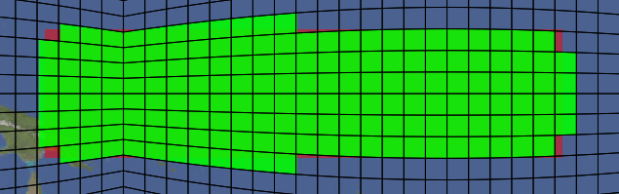
(2) Creating a New Grid
There are currently three programs to create a new grid:
SQuadGen -- Command line program
VRM_Editor -- Interactive GUI for SQuadGen
Create_VRMgrid -- Command line interface for VRM_Editor
These programs create the NE part of the cube-sphere grid and store the results in an EXODUS file.
SQuadGen
To use SQuadGen, the user first creates a rectangular PNG file with an image editor in which brightness values indicate the region of refinement.
Given a base resolution and a refinement level, this image is converted into a cube grid of discrete refinement levels.
The then program uses a specified set of templates to fill in the regions where there is a transition between resolutions
Each element for a NE grid is assigned an integer value indicating the level of refinement to perform.
AMWG Winter Meeting 2022

Slide 14
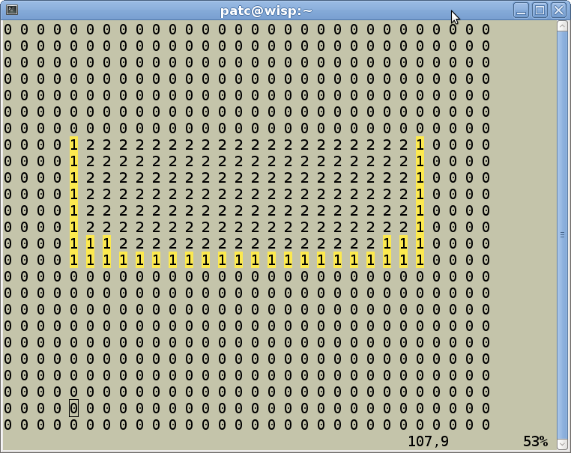
(2) Creating a New Grid
computer>./SQuadGen
Parameters:
--grid_type <string> ["CS"] (Options: ICO | CS)
--refine_type <string> ["LOWCONN"] (Options: LOWCONN | CUBIT | LOWCONNOLD)
--refine_level <integer> [2]
--resolution <integer> [10]
--refine_file <string> [""]
--output <string> [""]
--loadcsrefinementmap <bool> [false]
--smooth_type <string> ["NONE"] (Options: NONE | SPRING | PRESSURE)
--smooth_dist <integer> [1] (Smooth distance, -1 = smooth entire mesh)
--smooth_iter <integer> [10]
--lon_base <double> [-180.000000]
--lat_base <double> [0.000000]
--x_rotate <double> [0.000000]
--y_rotate <double> [0.000000]
--tessellate <integer> [0]
--subcellres <integer> [0]
--invert <bool> [false]
--block_refine <bool> [false]
SQuadGen
SQuadGen has command line options to specify the refinement resolutions, template type, smoothing options, and rotation angles which control the resulting grid.
Running the program with no options will produce a listing of the available options.
The program also writes out the discrete refinement values in a text file that can be edited manually.
Users can iteratively edit and feed these values back into SQuadGen to tailor the grid appearance as desired.

Slide 15
(2) Creating a New Grid
Re-run SQuadGen with the loadcsrefinementmap switch set to TRUE
computer>./SQuadGen
Parameters:
--grid_type <string> ["CS"] (Options: ICO | CS)
--refine_type <string> ["LOWCONN"] (Options: LOWCONN | CUBIT | LOWCONNOLD)
--refine_level <integer> [2]
--resolution <integer> [10]
--refine_file <string> [""]
--output <string> [""]
--loadcsrefinementmap <bool> [false]
--smooth_type <string> ["NONE"] (Options: NONE | SPRING | PRESSURE)
--smooth_dist <integer> [1] (Smooth distance, -1 = smooth entire mesh)
--smooth_iter <integer> [10]
--lon_base <double> [-180.000000]
--lat_base <double> [0.000000]
--x_rotate <double> [0.000000]
--y_rotate <double> [0.000000]
--tessellate <integer> [0]
--subcellres <integer> [0]
--invert <bool> [false]
--block_refine <bool> [false]
SQuadGen
SQuadGen has command line options to specify the refinement resolutions, template type, smoothing options, and rotation angles which control the resulting grid.
Running the program with no options will produce a listing of the available options.
Change these to 2’s to fix the corners
The program also writes out the discrete refinement values in a text file that can be edited manually.
Users can iteratively edit and feed these values back into SQuadGen to tailor the grid appearance as desired.
Change these to 1’s to extend a halo around the refined region
AMWG Winter Meeting 2022

Slide 16
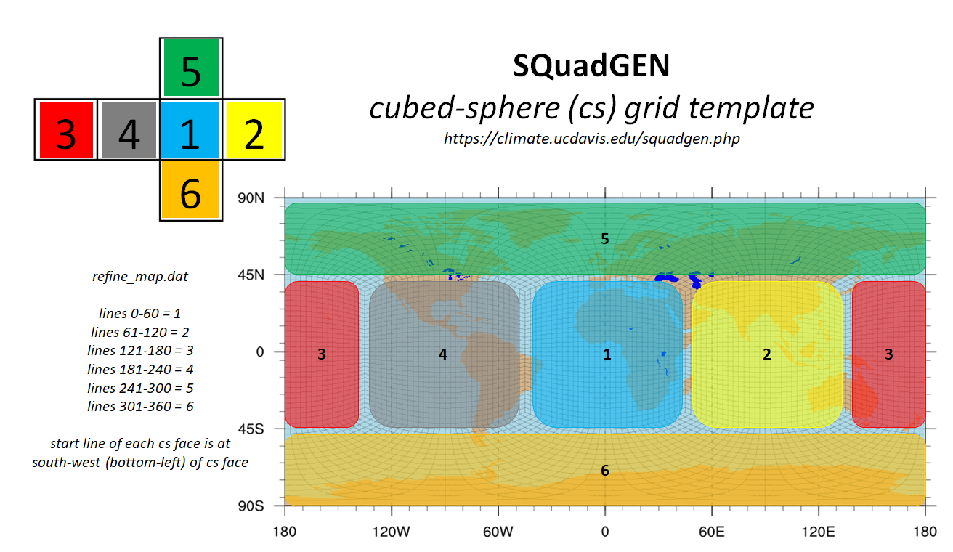
(2) Creating a New Grid
The layout of the values in the SQuadGen refinement file is illustrated in the following figure (Courtesy of Alan Rhodes)
AMWG Winter Meeting 2022

Slide 17
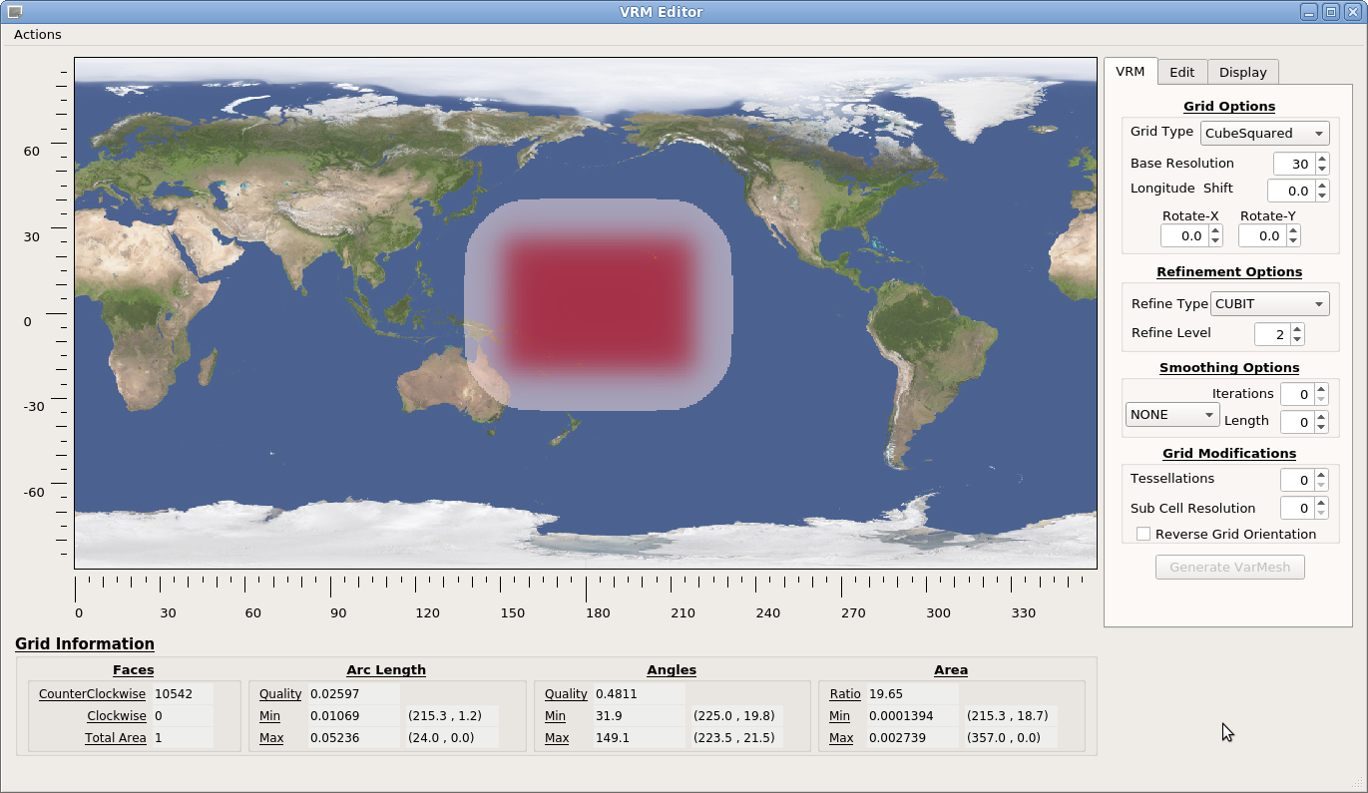
(2) Creating a New Grid
VRM_Editor
VRM_Editor is a GUI interface for SQuadGen but it uses a different approach to define refinements.
Rather than editing an image, the approach is to edit a map of continuous refinement values [0.,1.] on a (Lat,Lon) grid directly. Where values equal to 1, shown in red, define the desired region of refinement.
These values are stored/read from a netCDF file with a defined (Lat,Lon) grid rather than relying on an implied (Lat,Lon) grid for a rectangular image.
The Actions menu at the upper left has options for reading/writing refinement maps and newly created grids.
When a grid is created, the table at the bottom of the interface provides quality information about the grid. Including the min/max area, angle, arc length, and the locations of those extreme values.
On the right is a set of tools for editing and creating the grid.
AMWG Winter Meeting 2022

Slide 18
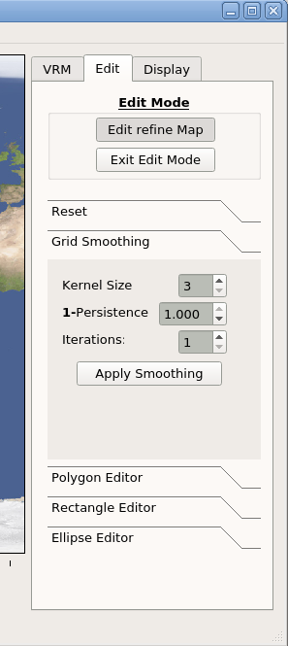
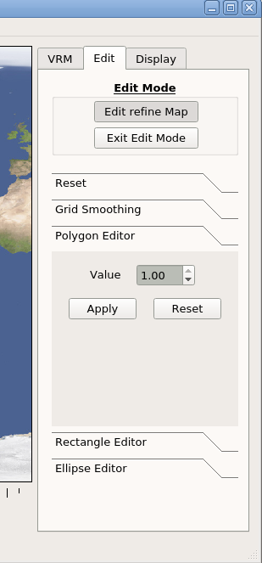
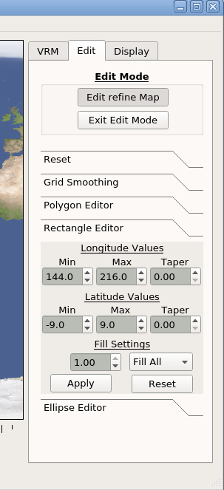
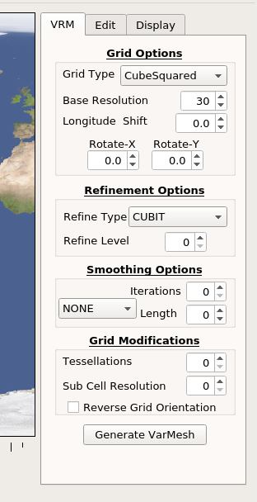
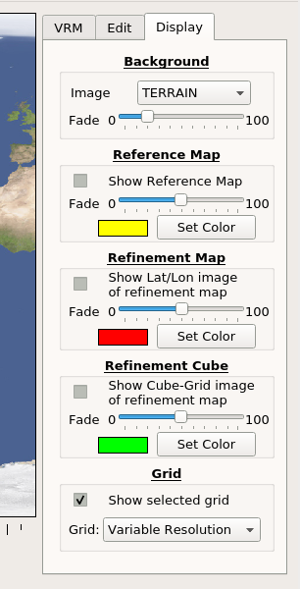
(2) Creating a New Grid
VRM_Editor
In addition to all of the SQuadGen options, the editor has tools used to create and modify the refinement map.
There is also set of options control the appearance of the displayed values in the editor.
AMWG Winter Meeting 2022

Slide 19
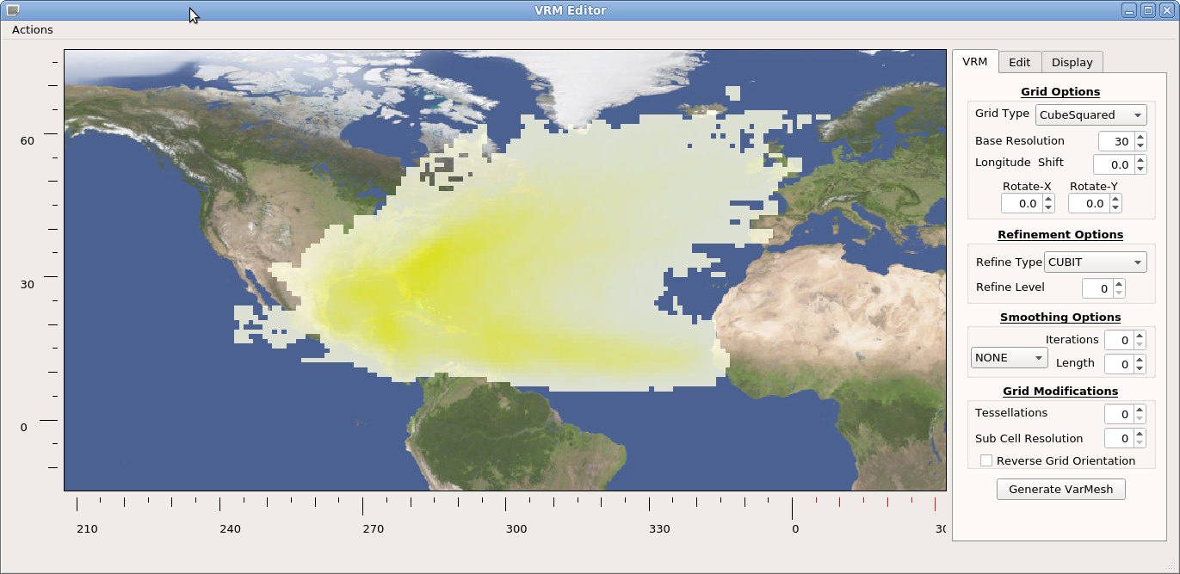
(2) Creating a New Grid
VRM_Editor
Optionally, a refence map based on observed phenomena can be read in and used as a guide for creating refined regions.
Values on a (Lat,Lon) grid are displayed with a yellow color gradient between min and max.
The example here is a PDF of tropical storm tracks in the Atlantic basin.
(available in the Demo_Files directory)
AMWG Winter Meeting 2022

Slide 20
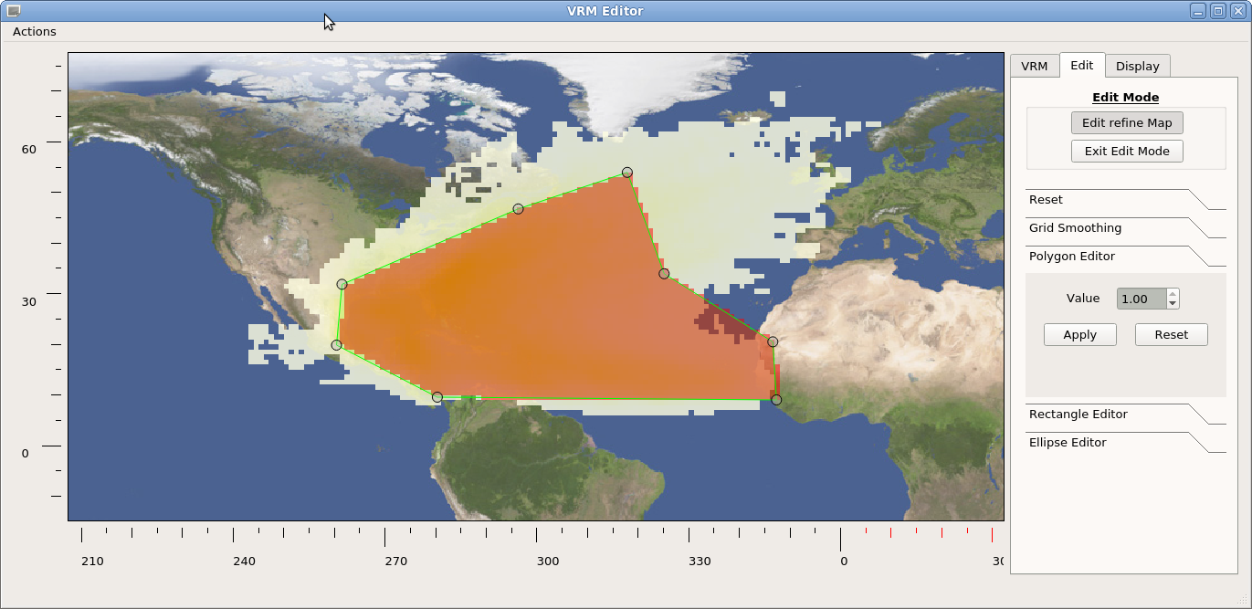
(2) Creating a New Grid
VRM_Editor
For a refinement from ne30 to ne120 for example there are 2 refinement levels.
The polygon editor can be used to first construct a ne120 region which encompasses the desired variability by setting a refinement value equal to 1.
AMWG Winter Meeting 2022

Slide 21
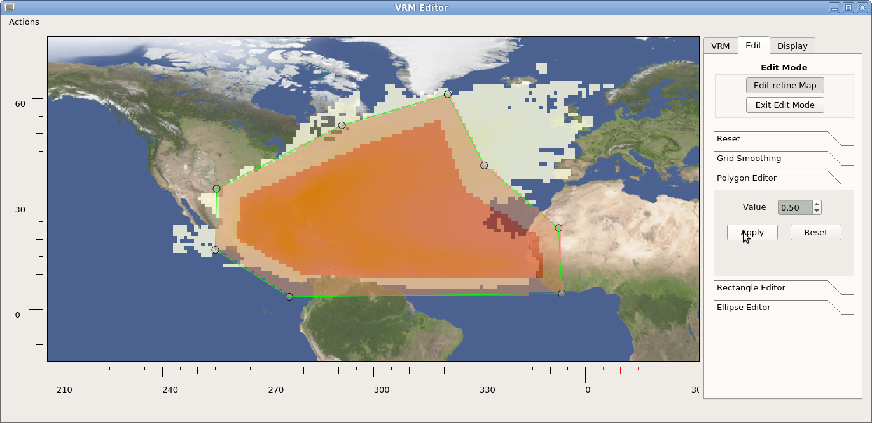
(2) Creating a New Grid
VRM_Editor
An expanded perimeter is then added with a value of 0.5 to define a transition region which will correspond to a ne60 grid resolution.
AMWG Winter Meeting 2022

Slide 22
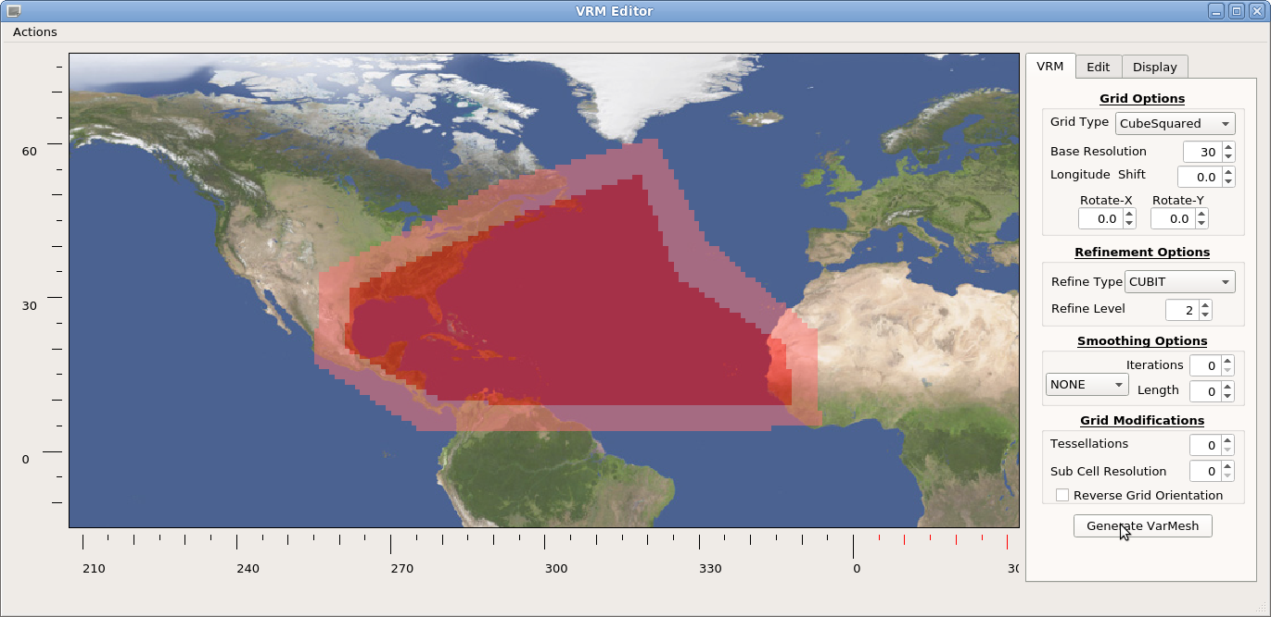
(2) Creating a New Grid
VRM_Editor
The resulting refinement map contains incremental changes between values with some sharp vertices.
AMWG Winter Meeting 2022

Slide 23
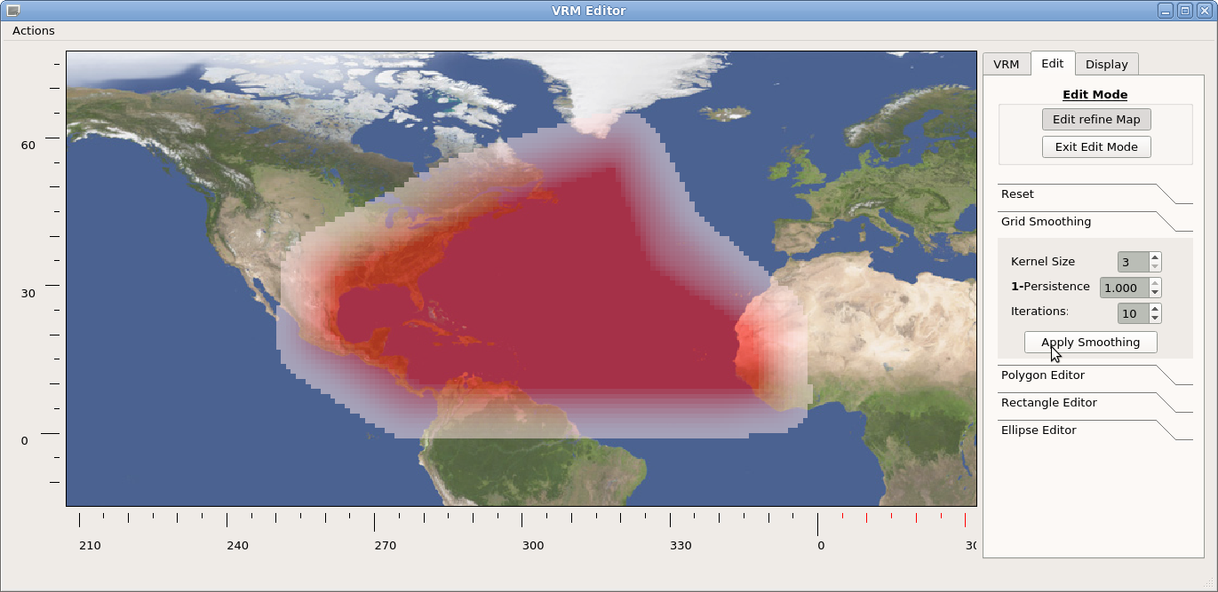
(2) Creating a New Grid
VRM_Editor
Using the smoothing tool, these rough edges can be rounded to get a more satisfactory refinement map.
AMWG Winter Meeting 2022

Slide 24
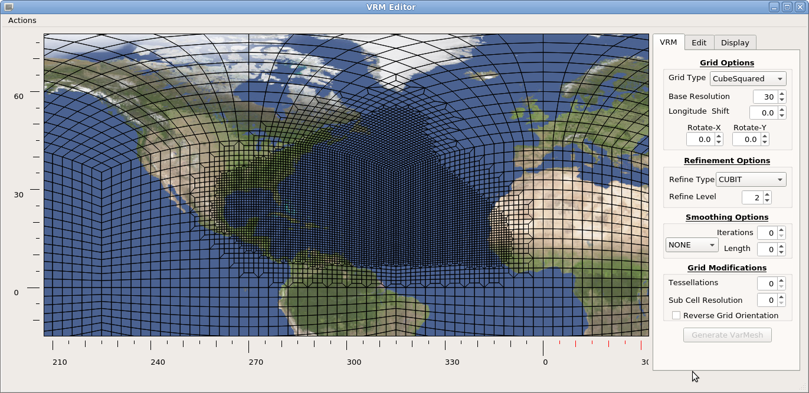
(2) Creating a New Grid
VRM_Editor
Once the refinement map changes are accepted, the SQuadGen parameters are set and the resulting refined grid generated.
AMWG Winter Meeting 2022

Slide 25
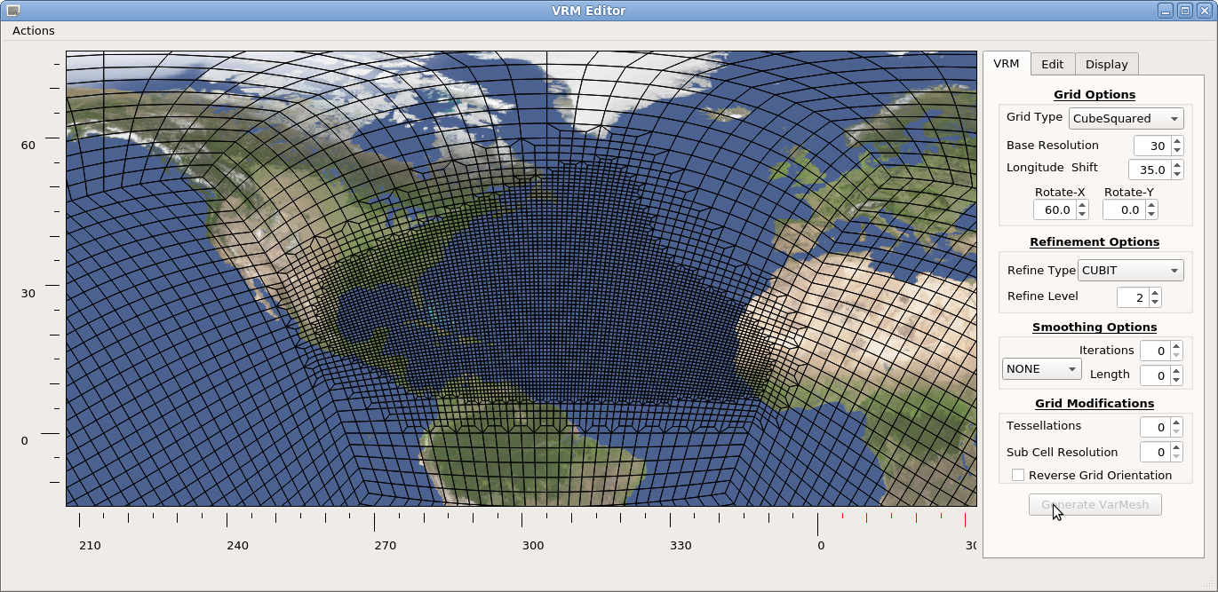
(2) Creating a New Grid
VRM_Editor
As a general rule, the refined regions should be centered, as much a possible, on one of the cube faces.
After adjusting values to rotate the base grid and selecting refinement and smoothing options, the final grid is ready to be saved.
AMWG Winter Meeting 2022

Slide 26
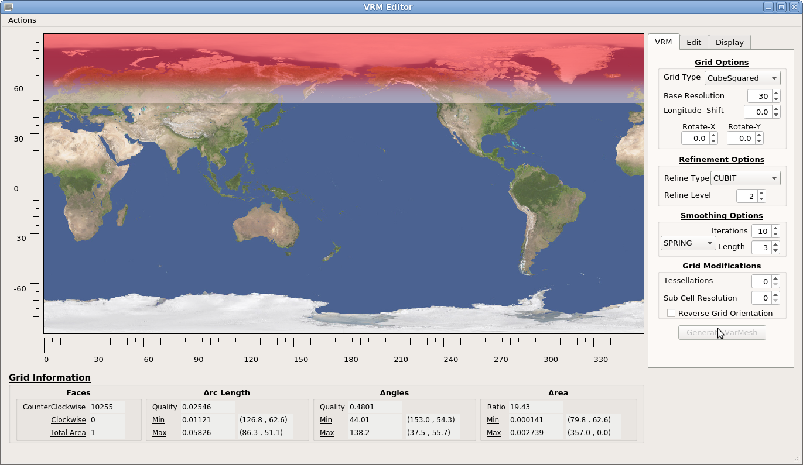
(2) Creating a New Grid
VRM_Editor
To create an ne30 grid which is refined to ne120 for Latitudes higher than 60N:
The rectangle editor is used to create a refinement map with value 1 over the pole, which tapers down to 0 at 60N.
AMWG Winter Meeting 2022

Slide 27
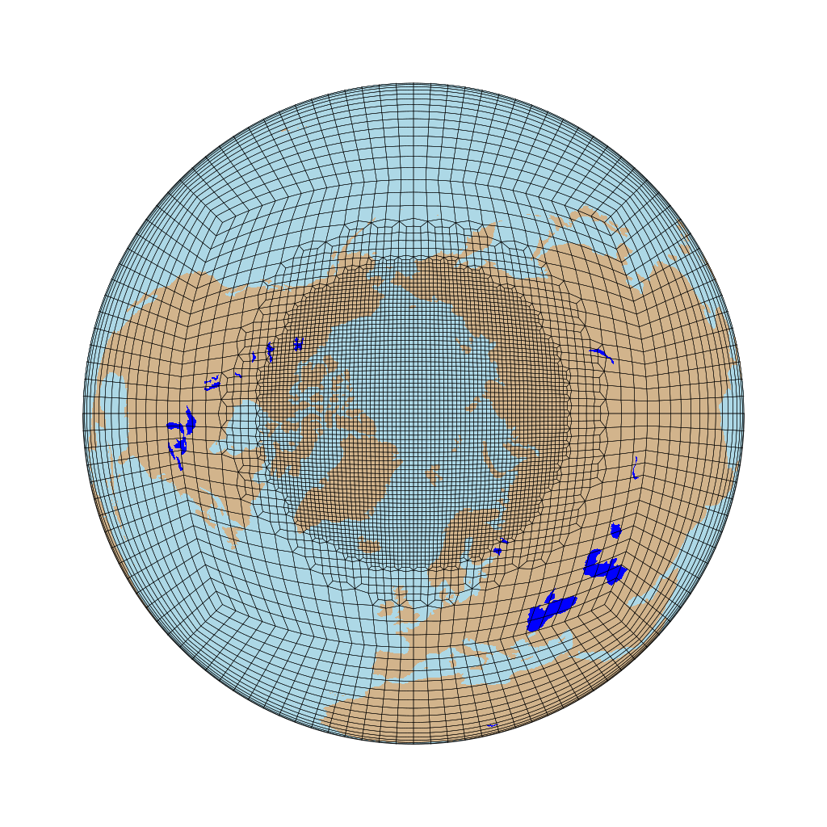
(2) Creating a New Grid
VRM_Editor
Setting the SQuadGen parameters for a ne30 base resolution, 2 refinements, and some grid smoothing creates a grid with a circumpolar refinement.
AMWG Winter Meeting 2022

Slide 28
(2) Creating a New Grid
VRM_Editor Refinement Levels
The range of refinement values is discretized and assigned to refinement levels as shown.
For ne240 the the refinement level is 3, so the interval in R values is (1/3). Setting values equal to 1 defines the highest resolution region.
Nominally, to specify a ne120 transition region around the ne240 domain, a halo of R values equal to 0.66 is added. Similarly, subsequent halos can be added using the appropriate value of R
For each element the average R value is discretized to the corresponding refinement level and this integer value is assigned to the element.
Note: To implement transitions between resolutions, SQuadGen automatically assigns refinement level values around the perimeter of a high resolution region to the next lowest resolution.
Consider a ne30 grid with a ne240 refinement.
PLAN AHEAD:
Work out these numbers for the refinement level you want so you know what values are needed for each intermediate refinement level.
R
1.00
ne240
R = 0.83
0.66
ne120
R = 0.50
0.33
ne60
R = 0.16
ne30
0.00
AMWG Winter Meeting 2022

Slide 29
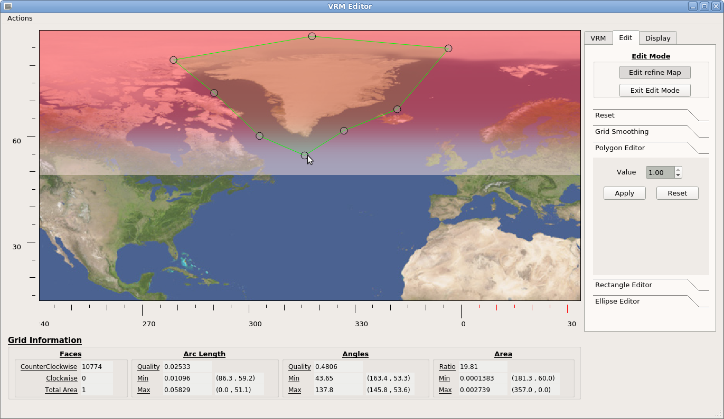
(2) Creating a New Grid
VRM_Editor
The polygon vertices are moved to create a region which encompasses Greenland.
AMWG Winter Meeting 2022

Slide 30
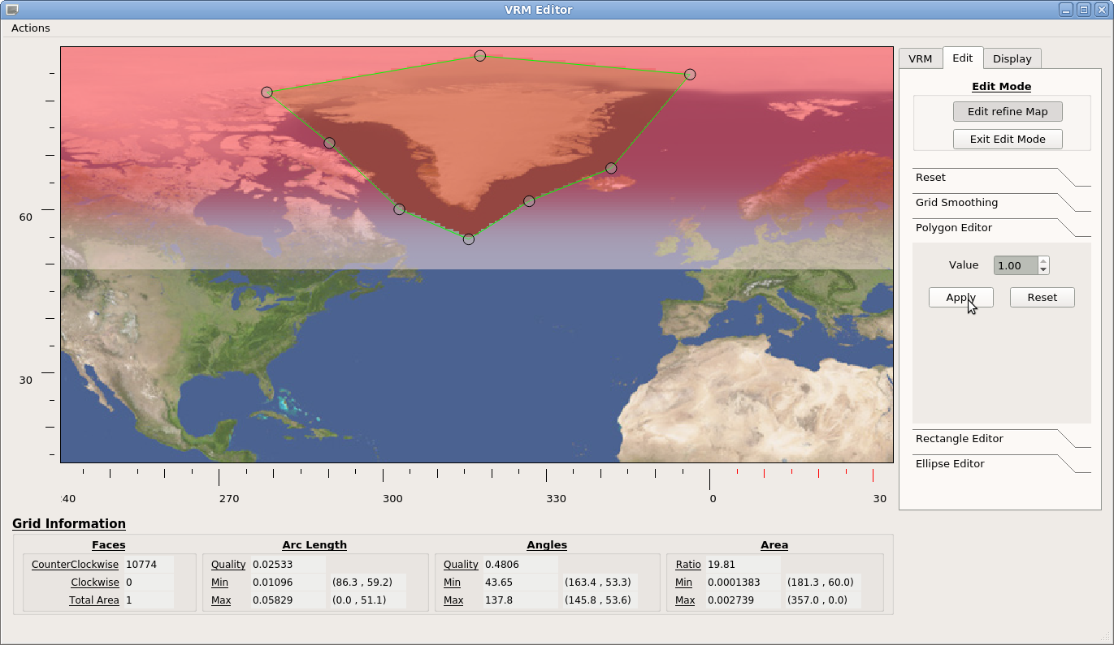
(2) Creating a New Grid
VRM_Editor
After the polygonal region is added, there is a relatively sharp transition between R=1 and R=0.82 values.
AMWG Winter Meeting 2022

Slide 31
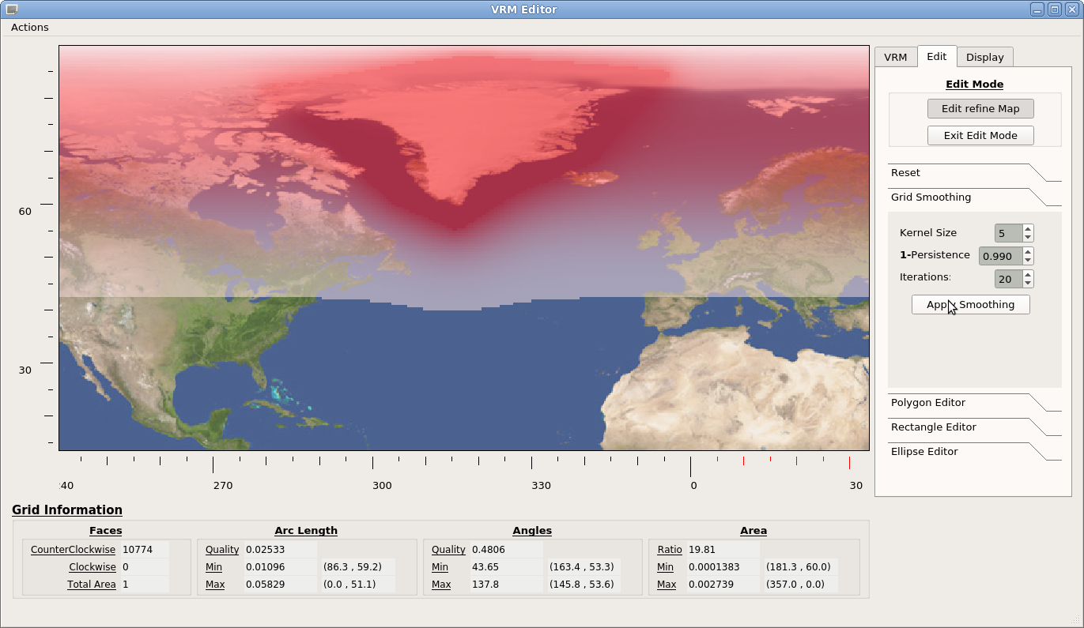
(2) Creating a New Grid
VRM_Editor
Apply smoothing to round the sharp edges.
AMWG Winter Meeting 2022

Slide 32
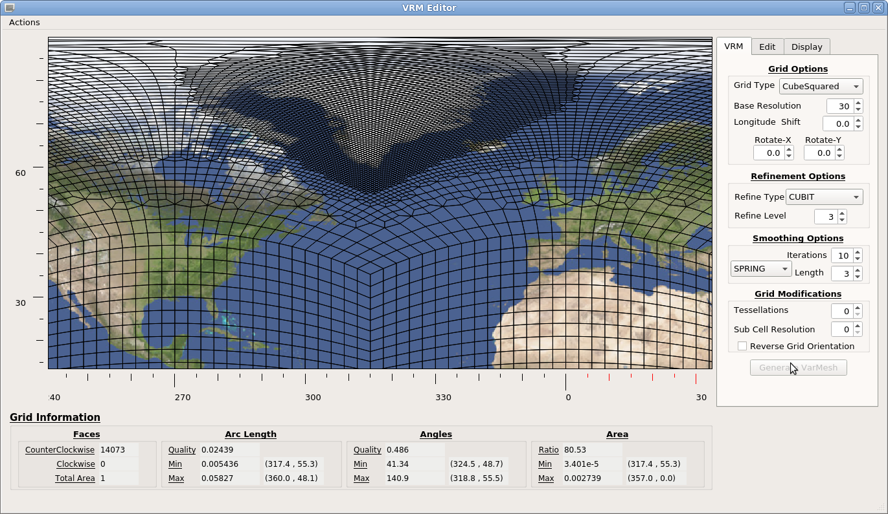
(2) Creating a New Grid
VRM_Editor
Then save the refinement map, set the SQuadGen parameters, and generate the grid
AMWG Winter Meeting 2022

Slide 33
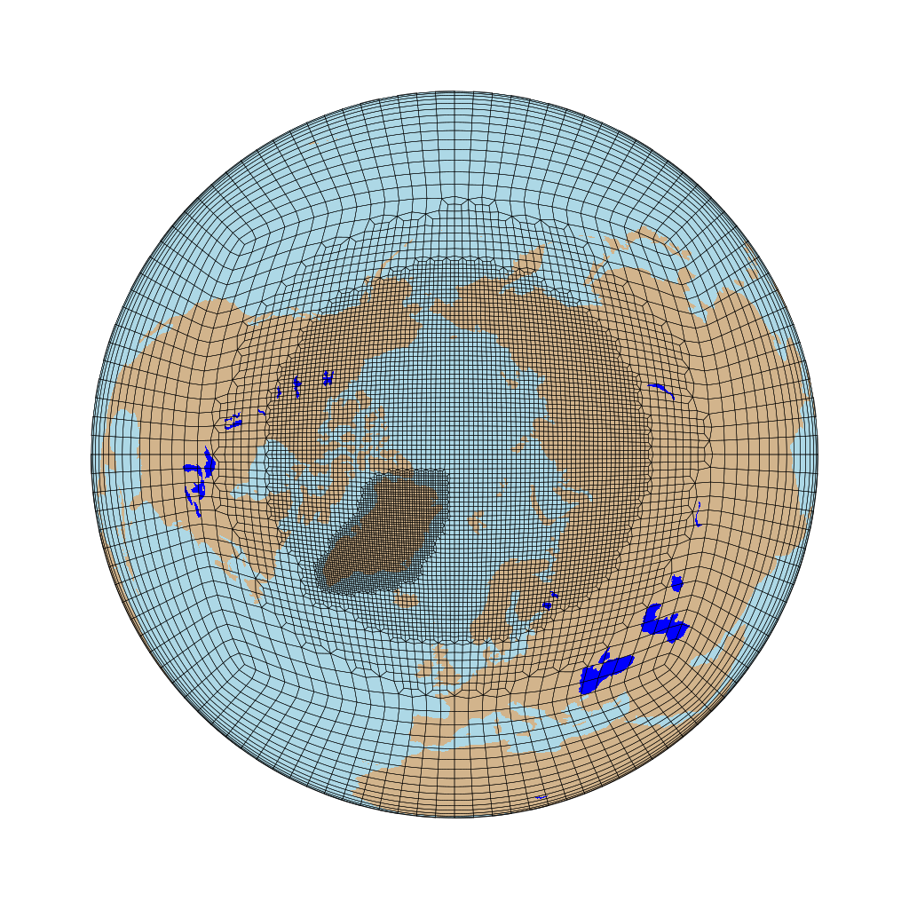
(2) Creating a New Grid
VRM_Editor
The final result is then a circumpolar refinement to ne120 over the North pole with a local refinement to ne240 over Greenland.
AMWG Winter Meeting 2022

Slide 34
(2) Creating a New Grid
New Features:
Changing Resolution of the Refinement Map:
Gen_REFMAP.ncl An NCL program that creates an empty (val=0) refinement map at a given resolution. Reading this map into the VRM_Editor will cause it to adjust and use the new resolution.
New Fill Options for the Polygon and Rectangle Editors:
Fill All: Fill the region with the given value
Fill MaxVal: Fill the region with MAX[ given value, existing refmap value].
Fill MinVal: Fill the region with MIN[ given value, existing refmap value].
Manual Editing With VRM_Editor/Create_VRMgrid:
VRM_Editor: “Write Refinement Cube” to save the discrete refinement values
Manual Edit: Use an editor (e.g. vi) to clean up grid problems
Create_VRMgrid: “--refine_cube” command line option to create the EXODUS file.
AMWG Winter Meeting 2022

Slide 35
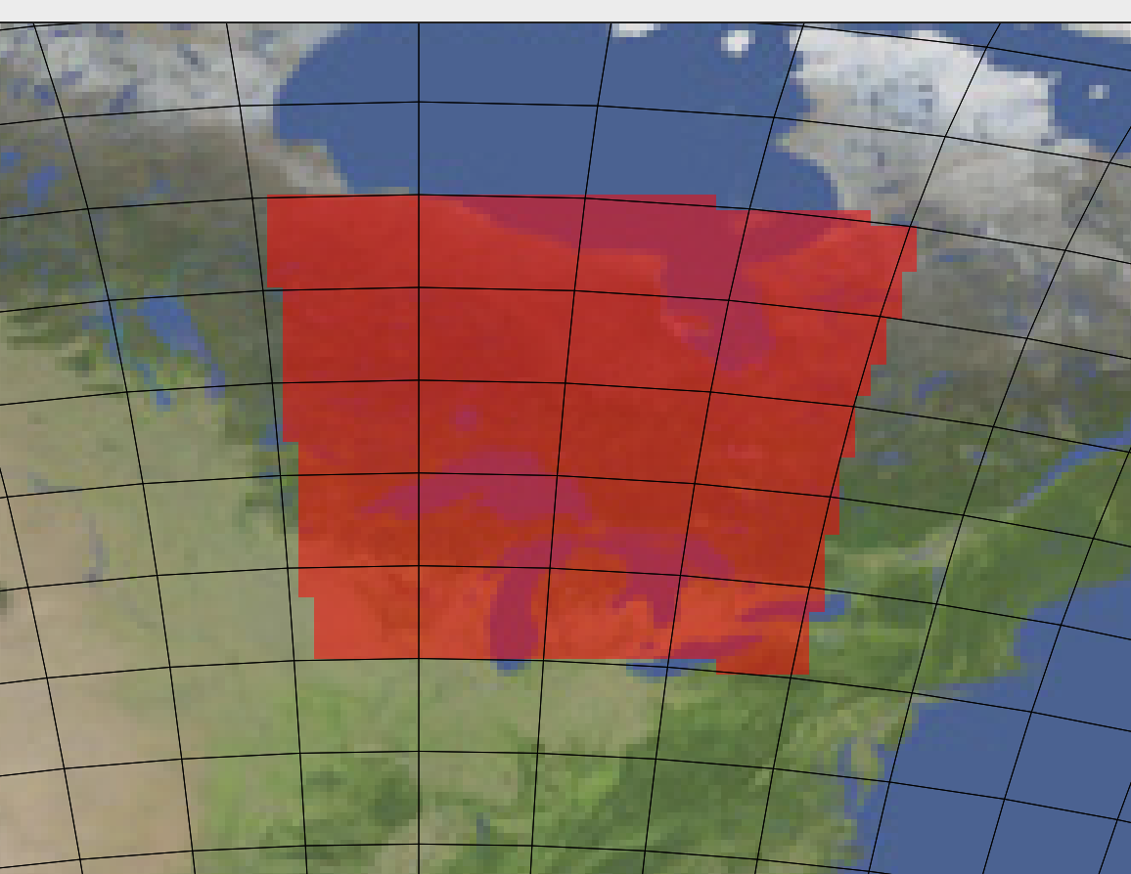

begin
;===============================================
; Set the Latitude Resolution and the Name of the
; refinement map to generate HERE:
;------------------------------------------------
; nlat = 180
; RefMap_Name = "REFMAP_360x180.nc"
;-----------------------------------
; nlat = 720
; RefMap_Name = "REFMAP_1440x720.nc"
;-----------------------------------
nlat = 1440
RefMap_Name = "REFMAP_2880x1440.nc"
;===============================================
(2) Creating a New Grid
New Features:
Gen_REFMAP.ncl
AMWG Winter Meeting 2022

Slide 36
(2) Creating a New Grid
Refinement Types
CUBIT: Uses a set of templates the size of the lower resolution grid to transition to a higher resolution
AMWG Winter Meeting 2022

Slide 37
(2) Creating a New Grid
Refinement Types
LOWCONN: Uses a set of templates that span 2x2 elements of the lower resolution grid to transition to a higher resolution
AMWG Winter Meeting 2022

Slide 38
(2) Creating a New Grid
Demonstration: Creating a South American refinement grid
Refer to the file: AMWG_DEMO_FEB22-NOTES
This file contains the step-by-step command I used to create and use an ne30 grid with a regional ne120 refinement over the South American continent.
Included are informative notes that were made along the way.
AMWG Winter Meeting 2022

Slide 39
(2) Creating a New Grid
====================================================================
(3) Create a new VR grid
====================================================================
cheyenne% execdav
casper% cd $(AMWG_DEMO_FEB22)/src/Community_Mesh_Generation_Toolkit/VRM_tools/VRM_Editor/src
casper% module load gnu/9.1.0
casper% ./VRM_Editor
---------------
**NOTE**:
---------------
The example grid will be an ne30 grid with a ne120 refinement centered over South America in
which the refinement region is a rectangle that is quasi-aligned with the rectangular grid of the
cube face. (equi-distant w.r.t. great circle lengths)
The nomenclature for the resulting EXODUS file is:
SAMGRID01_ne30x4_EXODUS.nc
-----------------
VRM_Editor:
-----------------
As a general rule, we always want to try and center the refined region
on a cube face. For this grid, that means S.America.
-Create a default grid - click ->Generate VarMesh
-Zoom in on S. America
-Set the grid rotation values to center on S.America:
Lon = 30. , X = 21. ->Generate VarMesh
- The grid line now provide a guide for creating the
rectangular region.
Use the Polygon Editor create the refinement region.
SAVE: Actions -> Save Refinement Map
---> REFMAP_SAMGRID01_Z30-X21
- Create initial grid: CUBIT/NOSMOOTH/ Refine=2
---------------
**NOTE**: {SEE: Img_SAMGRID01_1.png}
--------------- The geometric structure of the templates used for transition elements.
Note also, that the transition region(ne60) is small and not uniform around the perimeter.
- Two settings that help with this are the Refine Type and Smoothing options. The LOWCONN uses
templates that span 2x2 base elements to transition between resolutions, and the SPRING
smoothing rounds out the element shapes to ~reduce~ sharp angles.
LOWCONN SPRING: 3@3
SAVE: Actions -> Write Exodus File
---> SAMGRID01_ne30x4_EXODUS.nc
---------------
**NOTE**: {SEE: Img_SAMGRID01_2.png}
--------------- The smooth and uniform nature of the transition around the perimeter.
A good rule of thumb: The nicer the grid looks, the more uniform and symmetric it is, the
better it tends to behave numerically.
For some uses, the width of the transition region does not matter (e.g. nudged boundary
conditions). In other cases it is desirable to have a more gradual transition between the
high and low res regions.
- Use the polygon editor to add a 0.5 halo around the region.
---------------
**NOTE**: {SEE: Img_SAMGRID01_3.png}
--------------- The resulting grid extends the transition but uniformity and symmetry are out the
window. The command line program offers a method to fix this sort of behavior.
As an alternative to this, slight modifications to the rotation angles will change the
roundoffs in the refinement software which leads to better/worse behavior.
Iteratively adjusting these values invariably leads to a well behaver grid.
In this case: X=22.5 Lon=30.7
{SEE: Img_SAMGRID01_4.png}
SAVE: Actions -> Save Refinement Map
---> REFMAP_SAMGRID01_Z30.7-X22.5-HALO
SAVE: Actions -> Write Exodus File
---> SAMHALO01_ne30x4_EXODUS.nc

Slide 40
(2) Creating a New Grid
Create_VRMgrid
computer>./Create_VRMgrid
Input Parameters:
--refine_type <string> ["CUBIT"] (Options: CUBIT | LOWCONN | LOWCONNold)
--grid_type <string> ["CubeSquared"] (Options: Icosahedral | CubeSquared)
--smooth_type <string> ["NONE"] (Options: NONE | SPRING | PRESSURE)
--resolution <integer> [30]
--refine_level <integer> [0]
--tessellate <integer> [0]
--subcells <integer> [0]
--smooth_dist <integer> [0]
--smooth_iter <integer> [0]
--reverse_orient <bool> [false]
--x_rotate <double> [0.000000]
--y_rotate <double> [0.000000]
--lon_shift <double> [0.000000]
--refine_file <string> ["NULL"]
--output <string> ["NULL"]
--refine_cube <string> [“NULL”]
Create_VRMgrid is a command line interface that works very much like SQuadGen.
Rather than providing a PNG image, the user provides a netCDF file containing the refinement map values.
This file can be an output from the VRM_Editor, or a file created by some other means.
NEW OPTION: The VRM_Editor now has an option like SQuadGen to write out the discrete refinement levels to an ASCII file.
The user now has the option to edit the refinement domains and then use Create_VRMgrid to generate their grids.
Once the EXODUS file is created, transfer it to Cheyenne to create a repository:
Create $(AMWG_REPO)/ne0np4.SAMGRID01.ne30x4/
Create $(AMWG_REPO)/ne0np4.SAMGRID01.ne30x4/grids/ NOTE the naming conventions.
Copy SAMGRID01_ne30x4_EXODUS.nc to the grids/ directory.
AMWG Winter Meeting 2022

Slide 41
(2) Creating a New Grid
Create_VRMgrid
computer>./Create_VRMgrid
Input Parameters:
--refine_type <string> ["CUBIT"] (Options: CUBIT | LOWCONN | LOWCONNold)
--grid_type <string> ["CubeSquared"] (Options: Icosahedral | CubeSquared)
--smooth_type <string> ["NONE"] (Options: NONE | SPRING | PRESSURE)
--resolution <integer> [30]
--refine_level <integer> [0]
--tessellate <integer> [0]
--subcells <integer> [0]
--smooth_dist <integer> [0]
--smooth_iter <integer> [0]
--reverse_orient <bool> [false]
--x_rotate <double> [0.000000]
--y_rotate <double> [0.000000]
--lon_shift <double> [0.000000]
--refine_file <string> ["NULL"]
--output <string> ["NULL"]
--refine_cube <string> [“NULL”]
Create_VRMgrid is a command line interface that works very much like SQuadGen.
Rather than providing a PNG image, the user provides a netCDF file containing the refinement map values.
This file can be an output from the VRM_Editor, or a file created by some other means.
NEW OPTION: The VRM_Editor now has an option like SQuadGen to write out the discrete refinement levels to an ASCII file.
The user now has the option to edit the refinement domains and then use Create_VRMgrid to generate their grids.
The VRM settings needed for manual editing with the command line program are embedded in the EXODUS file created by VRM_Editor:
Cheyenne% ncdump SAMGRID01_ne30x4_EXODUS.nc | grep VRM
Once the refine_grid.dat file saved in VRM_Editor has been edited, pass it and the VRM settings to the command line program to create the final grid.
Once the EXODUS file is created, transfer it to Cheyenne to create a repository:
Create $(AMWG_REPO)/ne0np4.SAMGRID01.ne30x4/
Create $(AMWG_REPO)/ne0np4.SAMGRID01.ne30x4/grids/ NOTE the naming conventions.
Copy SAMGRID01_ne30x4_EXODUS.nc to the grids/ directory.
AMWG Winter Meeting 2022

Slide 42
(2) Creating a New Grid
Summary of Best practices
Refinement regions whose boundaries are aligned with (rectangular) spectral element grid lines tend to behave better numerically.
Regions that “look” good – have a uniform/symmetric appearance – tend to behave better numerically.
In general, it is better to use LOWCONN instead of CUBIT.
Convex regions tend to behave better numerically compared to regions that have concave edges.
When creating a high resolution region (e.g. ne240), try to make each halo (successive resolutions) several cells wide on all sides of the domain.
Generally, corner angles in the range (45-135) are okay, particularly with LOWCONN. Once the angles leave this range, users should identify the elements identified a the bottom of VRM_Editor and try to adjust the grid. [This is a FUZZY boundary!, elements that are near the limiting values may still be acceptable]
Try to center the refinement on a cube face.
AVOID aggressive refinement at the edges of the cube faces.
If you are having trouble with a grid, e.g. it needs large sub-cycling settings, then there is likely a problem with your grid. In the long run, you are better off iterating with variations/adjustments to your grid to get better performance.

Slide 43
(2) Creating a New Grid
Summary of Best practices (Cont)
When making a small refined region you might want to start with ne60 grid (instead of ne30).
In the polygon editor of VRM Editor, the number of vertices can not be increased more than 8. When making a large refined region try using multiple polygons in VRM Editor to get edges that follow the SE grid lines.
Sometime there are only minor irregularities along a refinement edge. To smooth edges in VRM Editor, try adjust Lon shift and Rotate-X, Rotate-Y by small amounts (0.1 deg), this sometimes resolves the problem.
You may want to save refinement map frequently, because the VRM editor sometimes crashes. When there is a crash, you can restart your work from the saving point.
If you are having trouble with a grid, e.g. it needs large sub-cycling settings, then there is likely a problem with your grid. In the long run, you are better off iterating with variations/adjustments to your grid to get better performance.
[YES!, This is worth saying twice]

Slide 44
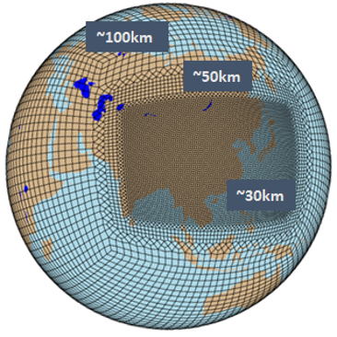
Some Variable Resolution Examples
AMWG Winter Meeting 2022

Slide 45
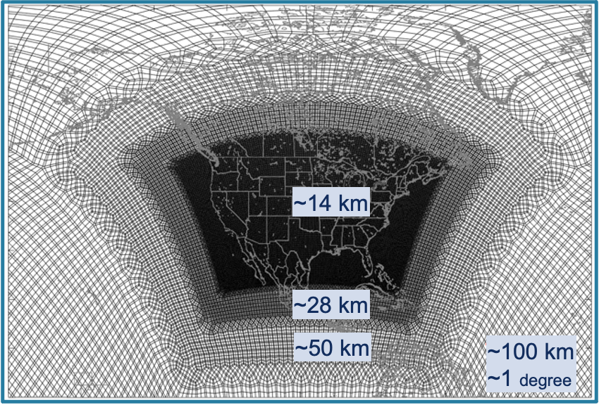
ne30x8 CONUS grid
Refined region follows base grid lines
Each intermediate resolution has several cells on all sides
Transition grid cells are generally uniform
AMWG Winter Meeting 2022

Slide 46
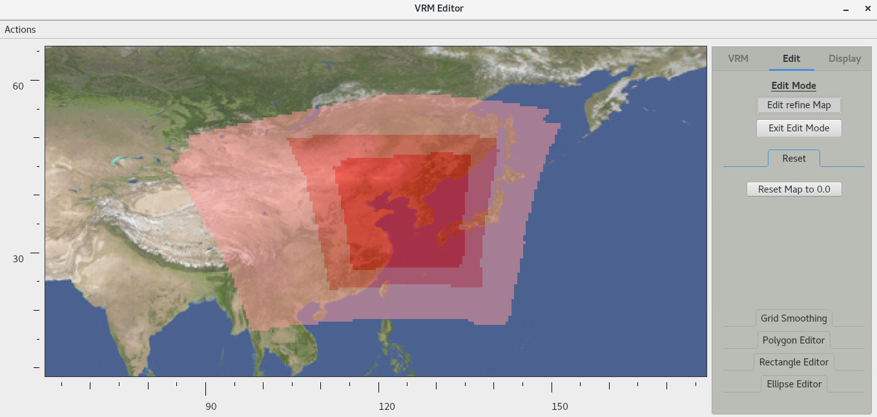
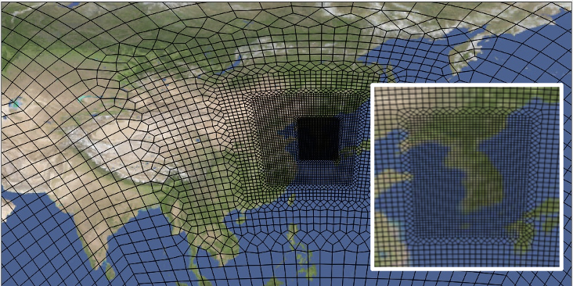
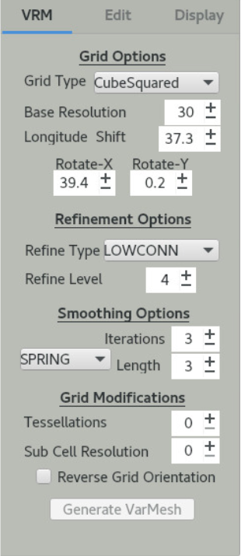
ne30x16, with 0.5, 0.25, 0.125 halos
Although refinement map looks irregular, grid is ok.
AMWG Winter Meeting 2022

Slide 47
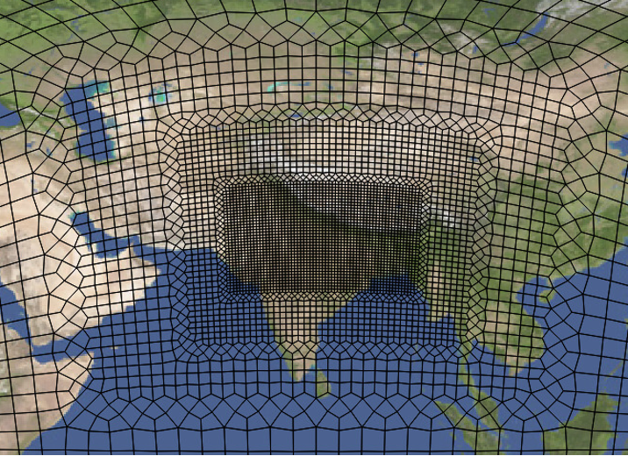
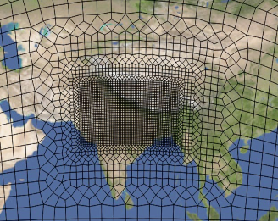
Preliminary grid - uneven halo
Final grid
AMWG Winter Meeting 2022

Slide 48
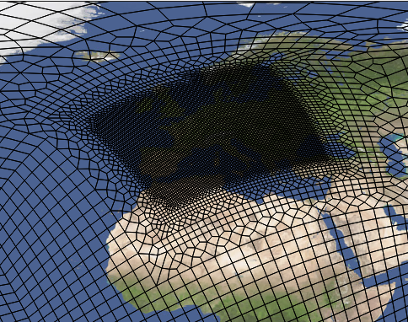
examples of poor grids - convex edges, weird transition grids, …
ne30x8, LOWCON, Spring: 3 iter. 0 length
Irregular halo
Bump on north side
SW corner is convex
Changing resolution across cube edge
AMWG Winter Meeting 2022

Slide 49
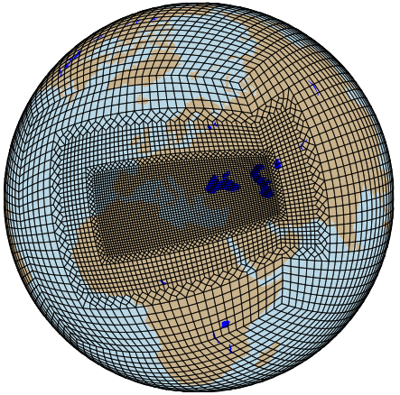
examples of poor grids - convex edges, weird transition grids, …
ne30x4, LOWCON
Really nice buffer zones!
But changing resolution across cube edge is no no!
AMWG Winter Meeting 2022

Slide 50
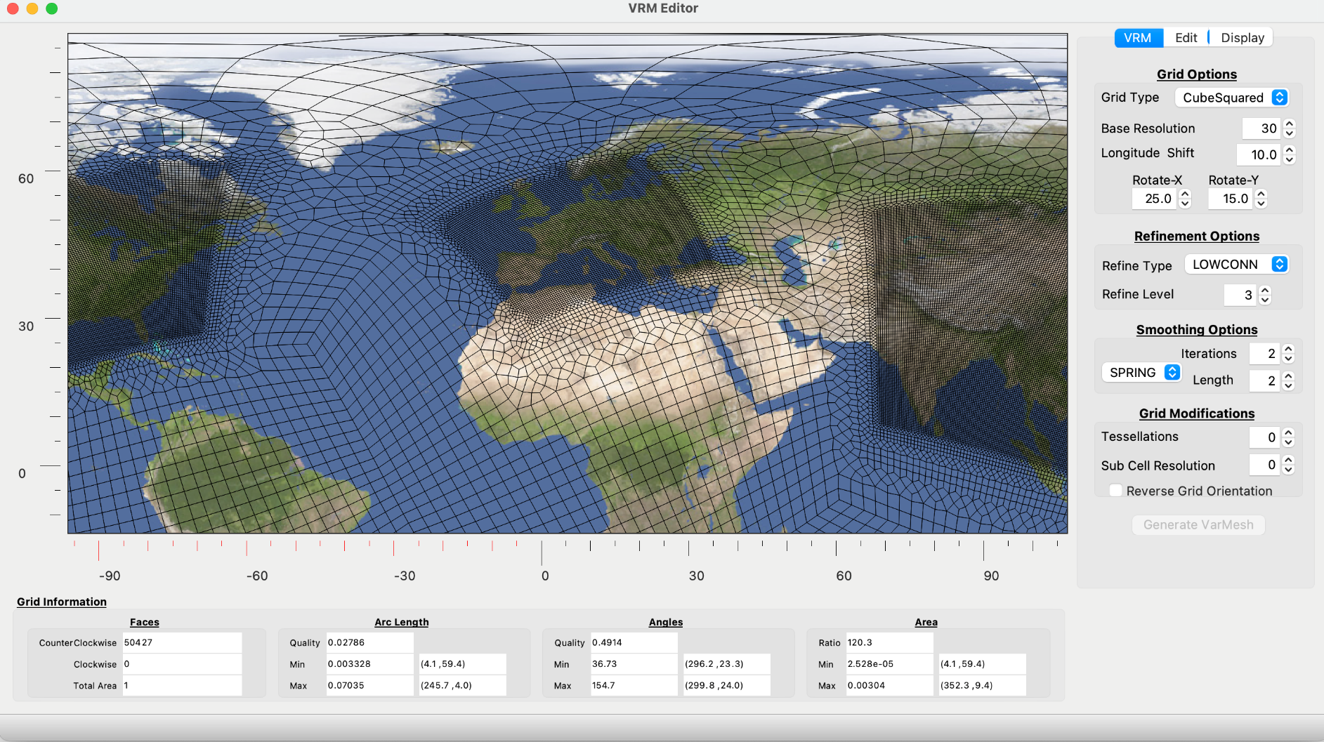
Potential problems where regions meet?
AMWG Winter Meeting 2022

Slide 51
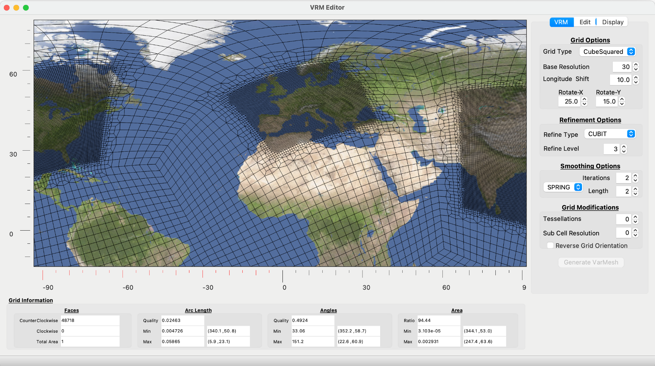
Same refinement map as previous, but with CUBIT - regions have a few ne30 grids separating them
AMWG Winter Meeting 2022

Slide 52
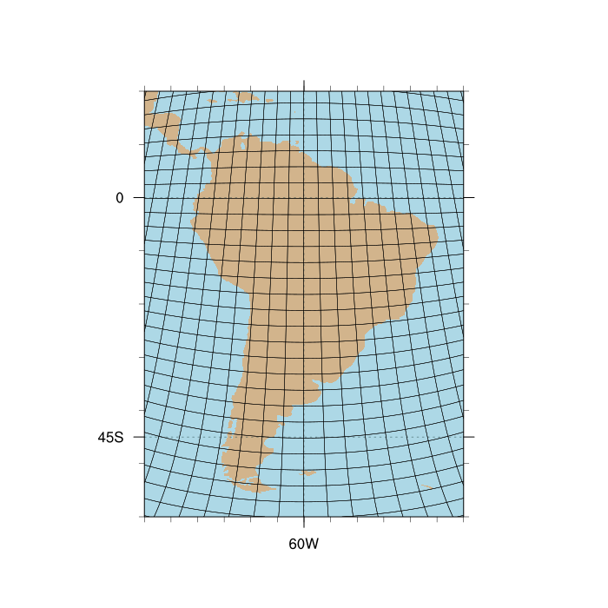
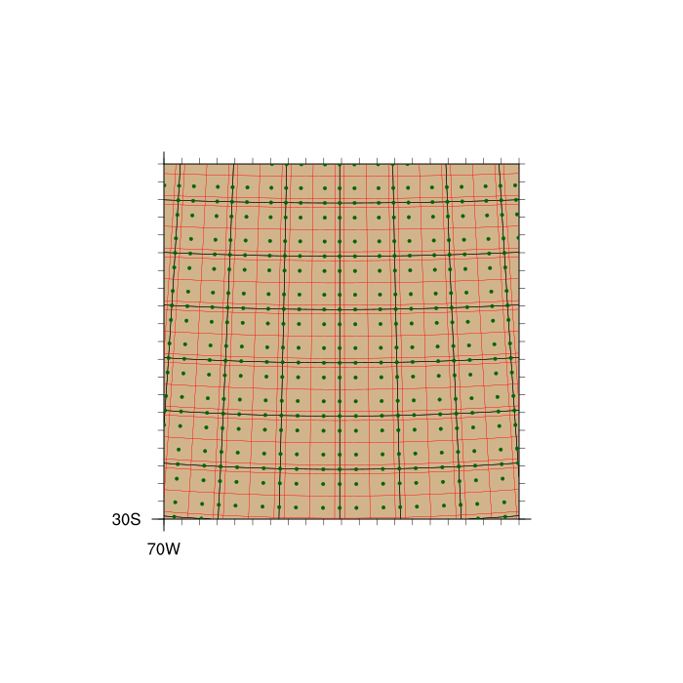
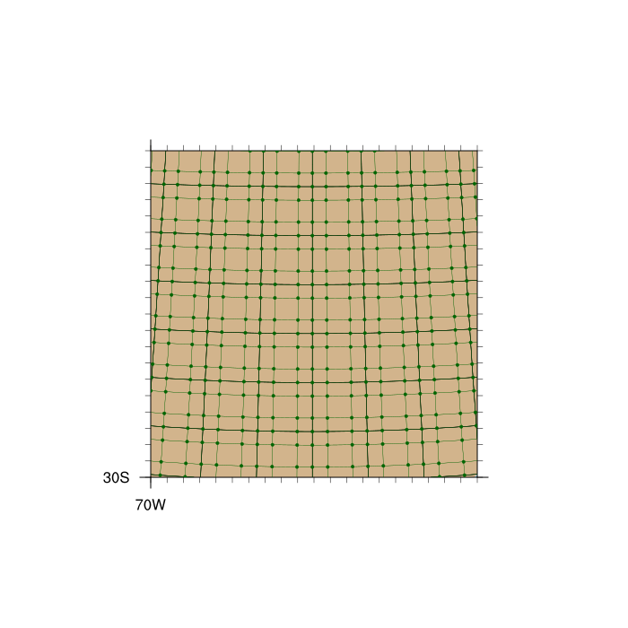
(2) Creating a New Grid
The Grids We Create:
SCRIP: contains spectral element grid points, the polygonal region associated with each point, and the corresponding area weight for each point.
LATLON: contains Lat, Lon, and area values found in the history files. It also contains the connectivity information for each quad region useful for graphing.
EXODUS: contains the quadrilateral spectral elements
MESH: An enhancement of the SCRIP file with additional information to optimize ESMF mapping functions.
AMWG Winter Meeting 2022

Slide 53
(3) Creating a Repository For The New Grid
Create a REPO Directory
If a repository for you grid and data files does not yet exist, create one. For now, we will use:
$(AMWG_DEMO_FEB22)/AMWG_REPO/
Create a directory in the REPO for the new grid:
ne0np4.SAMGRID01.ne30x4
Add your EXODUS file containing the NE part of the grid as a starting point. The contents of the EXODUS file are augmented with all of the VRM_Editor settings and refinement map used to create the grid.
For future use, it is a good practice to save REFMAP files in this directory as well.
====================================================================
(4) Create a REPO directory for the new grid;
Copy the EXODUS and REFMAP files to the REPO.
NOTATION: $(AMWG_DEMO_FEB22) == $(MY_FAVORITE_PATH)/AMWG_DEMO_FEB22
NOTATION: $(AMWG_REPO) == $(MY_FAVORITE_PATH)/AMWG_DEMO_FEB22/AMWG_REPO
====================================================================
cheyenne% mkdir $(AMWG_DEMO_FEB22)/AMWG_REPO
cheyenne% mkdir $(AMWG_DEMO_FEB22)/AMWG_REPO/ne0np4.SAMGRID01.ne30x4/
cheyenne% mkdir $(AMWG_DEMO_FEB22)/AMWG_REPO/ne0np4.SAMGRID01.ne30x4/grids
cheyenne% cp SAMGRID01_ne30x4_EXODUS.nc $(AMWG_DEMO_FEB22)/AMWG_REPO/ne0np4.SAMGRID01.ne30x4/grids
cheyenne% cp REFMAP_SAMGRID01_Z30-X21.nc $(AMWG_DEMO_FEB22)/AMWG_REPO/ne0np4.SAMGRID01.ne30x4/grids
cheyenne% ls -F $(AMWG_DEMO_FEB22)/AMWG_REPO/*/*
$(AMWG_DEMO_FEB22)/AMWG_REPO/ne0np4.SAMGRID01.ne30x4/grids:
REFMAP_SAMGRID01_Z30-X21.nc SAMGRID01_ne30x4_EXODUS.nc

Slide 54
(3) Creating a Repository For The New Grid
Gen_ControlVolumes
The process of generating the grid points is completed by running this program.
It adds the (NPxNP) GLL grid points for each element to support the Legendre basis functions and stores the final grid description in SCRIP/LATLON files.
When completed, the user has 3 separate files describing the grid.
====================================================================
(5) Create VR grids from EXODUS file
====================================================================
-------------------------------
Create SCRIP/LATLON grid files:
-------------------------------
cheyenne% cd $(AMWG_DEMO_FEB22)/src/Community_Mesh_Generation_Toolkit/VRM_tools/VRM_ControlVolumes/src
cheyenne% cp input.nl input.nl-ORIG
cheyenne% vi input.nl
- Set the namelist values to point to the new SAMGRID01 grid file and then run the
Gen_ControlVolumes program.
&input_nl
GridPath = ‘$(USER_DIR)/AMWG_DEMO_FEB22/AMWG_REPO/
ne0np4.SAMGRID01.ne30x4/grids/'
GridName = 'SAMGRID01_ne30x4'
/
cheyenne% module load gnu
cheyenne% ./Gen_ControlVolumes.exe input.nl > LOG_SAMGRID01.ne30x4 [ ~2 seconds to run]
cheyenne% ls $(AMWG_DEMO_FEB22)/AMWG_REPO/ne0np4.SAMGRID01.ne30x4/grids
REFMAP_SAMGRID01_Z30-X21.nc SAMGRID01_ne30x4_EXODUS.nc
SAMGRID01_ne30x4_np4_LATLON.nc SAMGRID01_ne30x4_np4_SCRIP.nc

Slide 55
(3) Creating a Repository For The New Grid
Set ENV Variables For Processing Scripts
The majority of steps from here on consist of a two step process:
(1) Run a MAKE script which uses a set
of environment variable to construct
the needed processing script.
(2) Run the scripts generated by MAKE.
Use ncdump on the LATLON file to get the number of grid points.
Then set the needed environment variables. See the REQUIRED_ENV_SETTINGS file in the VRM_tools directory for more information.
The VRM_DATE value here over-rides the creation dates typically generated by the processing programs.
- Get the number of columns in the new grid:
cheyenne% ncdump $(AMWG_DEMO_FEB22)/AMWG_REPO/ne0np4.SAMGRID01.ne30x4/grids/SAMGRID01_ne30x4_np4_LATLON.nc | grep ncol
ncol = 116534 ; <--- WE NEED THIS NUMBER!
double lat(ncol) ;
double lon(ncol) ;
double area(ncol) ;
cheyenne% setenv VRM_CESM_TAG ”$(AMWG_DEMO_FEB22)/src/cesm2_3_alpha08a/"
cheyenne% setenv VRM_REPO_PATH ”$AMWG_DEMO_FEB22)/AMWG_REPO/"
cheyenne% setenv VRM_GRID_TAG "SAMGRID01_ne30x4"
cheyenne% setenv VRM_GRID_NAME "ne0np4.SAMGRID01.ne30x4"
cheyenne% setenv VRM_GRID_NCOL "116534"
cheyenne% setenv VRM_DATE "220207”
--------------- The majority of the steps from here on involve a process in which a configuration script is run
**NOTE**: first. It uses these environment variables to generate the scripts that process the needed data.
--------------- See the file REQUIRED_ENV_SETTINGS in the $(VRM_tools) directory for more info.
Set VRM_DATE to the current date and keep it unchanged throughout the following steps. This
over-rides the date stamp that is generated by default. --- which caused scripting problems if the
user did not complete all VR data processing on the same calendar date.

Slide 56
(3) Creating a Repository For The New Grid
Create a MESH File:
The CESM model is in the process of transitioning to NUOPC/ESMF. When complete the mapping/domain files will be obsolete and replaced with functionality that only requires a MESH file.
For compatibility with this future change, a MESH file is created and stored with the other grid files.
After this step, the creation of the grid is complete and there are 4 separate files describing the new grid.
----------------------
Create MESH grid file:
----------------------
cheyenne% cd $(AMWG_DEMO_FEB22)/src/Community_Mesh_Generation_Toolkit/VRM_tools/gen_ESMFmesh/
cheyenne% ./MAKE_ESMFmesh_script.csh
cheyenne% execcasper
casper% cd ne0np4.SAMGRID01.ne30x4
casper% chmod 744 gen_ESMFmesh_SAMGRID01_ne30x4.sh
casper% ./gen_ESMFmesh_SAMGRID01_ne30x4.sh >& LOG_SAMGRID01_ne30x4 [ ~2 seconds]
casper% ls $(AMWG_DEMO_FEB22)/AMWG_REPO/ne0np4.SAMGRID01.ne30x4/grids
REFMAP_SAMGRID01_Z30-X21.nc SAMGRID01_ne30x4_np4_LATLON.nc
SAMGRID01_ne30x4_np4_SCRIP.nc SAMGRID01_ne30x4_EXODUS.nc
SAMGRID01_ne30x4_np4_MESH.nc
EXODUS = File convention for Finite Element Modeling
(NE part of the grid only)
SCRIP = Contains weights for interpolating between
grids in spherical coordinates
LATLON = Contains unique lat/lon grid points typically
found in history files.
PLUS connectivity information.
MESH = Contains enhanced information used for
ESMF interpolation.

Slide 57
(3) Creating a Repository For The New Grid
Generate Datasets
====================================================================
(6) Create VR Datasets
NOTATION: $(VRM_tools) == $(AMWG_DEMO_FEB22)/src/Community_Mesh_Generation_Toolkit/VRM_tools
====================================================================
----------------------
gen_mapping
----------------------
cheyenne% cd $(VRM_tools)/gen_mapping
cheyenne% ./MAKE_genMapping_scripts.csh
cheyenne% cd ne0np4.SAMGRID01.ne30x4/
cheyenne% qcmd -- 'sh gen_mapping_SAMGRID01_ne30x4_01.sh >& LOG_SAMGRID01_ne30x4_01' [ ~25 seconds ]
cheyenne% qcmd -- 'sh gen_mapping_SAMGRID01_ne30x4_02.sh >& LOG_SAMGRID01_ne30x4_02' [ ~40 seconds ]
cheyenne% qcmd -- 'sh gen_mapping_SAMGRID01_ne30x4_03.sh >& LOG_SAMGRID01_ne30x4_03' [ ~2:20 to run]
cheyenne% ls $(AMWG_DEMO_FEB22)/AMWG_REPO/ne0np4.SAMGRID01.ne30x4/
grids/ maps/
----------------------
gen_domain
----------------------
cheyenne% cd $(VRM_tools)/gen_domain
cheyenne% ./MAKE_genDomains_scripts.csh
cheyenne% cd ne0np4.SAMGRID01.ne30x4/
cheyenne% qcmd -- 'sh genDomains_SAMGRID01_ne30x4_gx1v7.sh >& LOG_SAMGRID01_ne30x4_gx1v7’ [~0:20 to run]
cheyenne% qcmd -- 'sh genDomains_SAMGRID01_ne30x4_tx0.1v2.sh >& LOG_SAMGRID01_ne30x4_tx0.1v2' [~7:30 to run]
cheyenne% ls $(AMWG_DEMO_FEB21)/AMWG_REPO/ne0np4.SAMGRID01.ne30x4/
domains/ grids/ maps/
----------------------
gen_CLMsrfdata
----------------------
cheyenne% cd $(VRM_tools)/gen_CLMsrfdata
cheyenne% ./MAKE_genCLMsurfdata_script.csh
cheyenne% cd ne0np4.SAMGRID01.ne30x4/
cheyenne% vi genCLMsurfdata_SAMGRID01_ne30x4.sh <---- MUST SET A PROJECT NUMBER!
cheyenne% qsub < genCLMsurfdata_SAMGRID01_ne30x4.sh [ ~1:00:00 one hour for this grid]
cheyenne% ls $(AMWG_DEMO_FEB22)/AMWG_REPO/ne0np4.SAMGRID01.ne30x4/
clm_surfdata_5_0/ grids/
The user begins by setting some grid-dependent environment variables
After that, the process is the same for each of the gen_XXXX directories:
cd to the gen_XXXX directory
Run a script which generates a grid directory containing the processing scripts that will generate the needed datasets.
Verify the settings in each script and then run it.
Check the output LOG file to verify that the program did not have any errors.
Obsolete
The majority of problems users have during this process is a result of not having the correct modules loaded. To try and avoid confusion, modules are explicitly listed before each command in the NOTES file. (omitted here)

Slide 58
(3) Creating a Repository For The New Grid
Generate Datasets
----------------------
gen_CAMncdata
----------------------
cheyenne% cd $(VRM_tools)/gen_CAMncdata
cheyenne% ./MAKE_interpic_script.csh
cheyenne% cd ne0np4.SAMGRID01.ne30x4/
cheyenne% qcmd -- 'sh interpic_script_SAMGRID01_ne30x4.sh >& LOG_SAMGRID01_ne30x4' [~0:30 to run]
cheyenne% ls $(AMWG_DEMO_FEB22)/AMWG_REPO/ne0np4.SAMGRID01.ne30x4/
clm_surfdata_5_0/ grids/ inic/
----------------------
gen_atmsrf
----------------------
cheyenne% cd $(VRM_tools)/gen_atmsrf
cheyenne% ./MAKE_genAtmsrf_script.csh
cheyenne% cd ne0np4.SAMGRID01.ne30x4/
cheyenne% qcmd -- 'ncl gen_atmsrf_SAMGRID01_ne30x4.ncl >& LOG_SAMGRID01_ne30x4' [~1:00 to run]
cheyenne% ls $(AMWG_DEMO_FEB22)/AMWG_REPO/ne0np4.SAMGRID01.ne30x4/
atmsrf/ clm_surfdata_5_0/ grids/ inic/
----------------------
gen_topo
----------------------
cheyenne% cd $(VRM_tools)/gen_topo/Regrid_topo
cheyenne% ./MAKE_RegridTopo_script.csh
cheyenne% cd ne0np4.SAMGRID01.ne30x4/
cheyenne% qcmd -- 'ncl Regrid_topo_SAMGRID01_ne30x4.ncl >& LOG_SAMGRID01_ne30x4' [~0:30 to run]
cheyenne% ls $(AMWG_DEMO_FEB22)/AMWG_REPO/ne0np4.SAMGRID01.ne30x4/
atmsrf/ clm_surfdata_5_0/ grids/ inic/ topo/
The CLM and true topography files take the longest to generate.
The Regrid_topo script shown here only interpolates the current ne120 topography file and should only be used for testing when the true topography file is not available.

Slide 59
(3) Creating a Repository For The New Grid
====================================================================
(7) Generate TRUE topography
====================================================================
------------------------
Check out topo software
------------------------
cheyenne% cd $(VRM_tools)/gen_topo
cheyenne% mkdir topo
cheyenne% git clone https://github.com/NCAR/Topo.git topo
cheyenne% cd topo
------------------------------------------------
Configure for the new grid and run the program
------------------------------------------------
cheyenne% execcasper
casper% cp experiment_settings.make experiment_settings.make-ORIG
casper% vi experiment_settings.make
- Comment out the current 'export case=' line
- Add: export case=SAMGRID01.30_x4_C0060_ridge
- Add setting for this case:
ifeq ($(case),SAMGRID01.30_x4_C0060_ridge)
export ncube_sph_smooth_coarse=060
export output_grid=topo_ne0np4.SAMGRID01.ne30x4
export grid_descriptor_fname=$(AMWG_DEMO_FEB22)/AMWG_REPO/
ne0np4.SAMGRID01.ne30x4/grids/SAMGRID01_ne30x4_np4_SCRIP.nc
export nwindow_halfwidth=042
export rdgwin=_Nsw$(nwindow_halfwidth)
export stitch=-stitch
export ncube=3000
export lregional_refinement=.true.
export rrfac_max=4
export lread_smooth_topofile=.false.
case_found=
endif
casper% module load gnu
casper% make [ ~1:30:00 to run]
Generate TRUE Topography Dataset
When editing the experiment_settings.make file, use an existing grid with a similar refinement as a guide for adding your new grid.
Be careful, make sure that the rrfac_max value matches the refinement level of your grid.
Not designed for ~3km resolutions.... YET! In the meantime, generate a ~ne480~ refinement topography for your region and then adapt the Regrid_topo script to interpolate values from this file.
Copy the topo file to REPO directory:
Note that for this topo file the user MUST add the VRM_DATE value to the end of the filename.
where $(TOPO) == $(AMWG_REPO)/ne0np4.SAMGRID01.ne30x4/topo/
---------------------------
Copy topo file to the REPO
---------------------------
casper% cd cube_to_target/output
casper% cp topo_ne0np4.SAMGRID01.ne30x4_nc3000_Co060_Fi001_MulG_PF_RR_Nsw042.nc
$(TOPO)/topo_ne0np4.SAMGRID01.ne30x4_nc3000_Co060_Fi001_MulG_PF_RR_Nsw042_220207.nc

Slide 60
(3) Creating a Repository For The New Grid
====================================================================
(7) Generate TRUE topography
====================================================================
------------------------
Check out topo software
------------------------
cheyenne% cd $(VRM_tools)/gen_topo
cheyenne% mkdir topo
cheyenne% git clone https://github.com/NCAR/Topo.git topo
cheyenne% cd topo
------------------------------------------------
Configure for the new grid and run the program
------------------------------------------------
cheyenne% execcasper
casper% cp experiment_settings.make experiment_settings.make-ORIG
casper% vi experiment_settings.make
- Comment out the current 'export case=' line
- Add: export case=SAMGRID01.30_x4_C0060_ridge
- Add setting for this case:
ifeq ($(case),SAMGRID01.30_x4_C0060_ridge)
export ncube_sph_smooth_coarse=060
export output_grid=topo_ne0np4.SAMGRID01.ne30x4
export grid_descriptor_fname=$(AMWG_DEMO_FEB22)/AMWG_REPO/
ne0np4.SAMGRID01.ne30x4/grids/SAMGRID01_ne30x4_np4_SCRIP.nc
export nwindow_halfwidth=042
export rdgwin=_Nsw$(nwindow_halfwidth)
export stitch=-stitch
export ncube=3000
export lregional_refinement=.true.
export rrfac_max=4
export lread_smooth_topofile=.false.
case_found=
endif
casper% module load gnu
casper% make [ ~1:30:00 to run]
Generate TRUE Topography Dataset
When editing the experiment_settings.make file, use an existing grid with a similar refinement as a guide for adding your new grid.
Be careful, make sure that the rrfac_max value matches the refinement level of your grid.
Not designed for ~3km resolutions.... YET! In the meantime, generate a ~ne480~ refinement topography for your region and then adapt the Regrid_topo script to interpolate values from this file.
Expect the process for creating TRUE topography to change in the near future!
The steps will be greatly simplified and problems with creating high resolution topography (~3km) will be resolved.
Copy the topo file to REPO directory:
Note that for this topo file the user MUST add the VRM_DATE value to the end of the filename.
where $(TOPO) == $(AMWG_REPO)/ne0np4.SAMGRID01.ne30x4/topo/
---------------------------
Copy topo file to the REPO
---------------------------
casper% cd cube_to_target/output
casper% cp topo_ne0np4.SAMGRID01.ne30x4_nc3000_Co060_Fi001_MulG_PF_RR_Nsw042.nc
$(TOPO)/topo_ne0np4.SAMGRID01.ne30x4_nc3000_Co060_Fi001_MulG_PF_RR_Nsw042_220207.nc

Slide 61
(3) Creating a Repository For The New Grid
/my/local/repo/
When there steps are completed, the user has generated a repository of required values for each grid, stored with the following directory structure:
Now an Install script create set the default namelist files and shell commands used when a new case is created
ne0np4.SAMGRID01.ne30x4/
ne0np4.MyOtherGrid.ne30x8/
atmsrf/
atmsrf/
domains/
domains/
grids/
Obsolete
grids/
inic/
inic/
maps/
maps/
topo/
topo/
clm_surfdata_5_0/
clm_surfdata_5_0/

Slide 62
(4) Installing The New Grid
Install The New Grid
In the same manner as generating datasets, the user just has to run a MAKE script.
An additional ENV variable VRM_TOPO_TAG must be set to specify the topo file that will be used by default.
Before running it, the install script must be edited to add a grid description for the new grid.
====================================================================
(8) Install the new Grid
====================================================================
Set the environment variable for the default topo file to use:
DIAG Interp topo => cheyenne% setenv VRM_TOPO_TAG "blin"
TRUE topo file => cheyenne% setenv VRM_TOPO_TAG "nc3000_Co060_Fi001_MulG_PF_RR_Nsw042”
cheyenne% setenv VRM_TOPO_TAG "nc3000_Co060_Fi001_MulG_PF_RR_Nsw042”
cheyenne% cd $(VRM_tools)/Install_grid/NUOPC_TAGS
cheyenne% ./MAKE_install_script.csh
- Edit the GRIDDESC value: Add a meaningful description of the new grid
cheyenne% vi Install_grid_SAMGRID01_ne30x4.csh
set GRIDDESC = "A rotated ne30 base grid with ne120 refinement over South America”
cheyenne% chmod 744 Install_grid_SAMGRID01_ne30x4.csh
cheyenne% ./Install_grid_SAMGRID01_ne30x4.csh
cheyenne% ls $(AMWG_DEMO_FEB22)/AMWG_REPO/ne0np4.SAMGRID01.ne30x4/
atmsrf/ clm_surfdata_5_0/ config_grids.xml grids/
inic/ shell_commands topo/ user_nl_cam user_nl_clm
This installation script adds 4 files to the $(REPO) directory:
config_grids.xml contains the grid description for CESM
shell_commands Sets the pelayout and the model timestep
user_nl_clm Contains the landuse datasets.
user_nl_cam Contains the &dyn_se_inparm namelist values
Adding these files completes the installation!
The only updates that should be needed for the repository are if there is are model updates to the XML file formats, the namelist values, or to the source input datasets for newer tags.
This REPO can now be used by any users with read permission in the directory, and in general, will work for all other compatible CESM tags.
(tags that are compatible with cesm2_3_alpha08a in this case)

Slide 63
(5) Establishing Defaults
Create a new Case
The user just need to add a –user-mods-dir argument to the newcase command to use the grid.
./create_newcase –case MyCaseName –res ne0np4.MyGridName.ne30x4_mt12 —compset FHIST
–mach cheyenne –run-unsupported –user-mods-dir $(MyRepoPath)/ne0np4.MyGridName.ne30x4
In the case directory, the user_nl_cam has the defaults settings. These must be adjusted iteratively until the model runs stably.
For ne120 refinements, the values for a uniform ne120np4 grid will likely work unless the refinement created a small element in the transition region.
The Processing scripts created grids for both ‘mt12’ and ‘mg17’. Typically it is best to use the ‘mt12’ grid, but users have the option to choose.
====================================================================
(9) Create a newcase and begin the process of adjusting timestep/namelist values.
====================================================================
cheyenne% cd $(AMWG_DEMO_FEB22)/src/cesm2_3_alpha08a/cime/scripts
cheyenne% ./create_newcase --case $(AMWG_DEMO_FEB22)/cases/f.e22r.SAMGRID01.ne30x4.AMWGtest_01
--res ne0np4.SAMGRID01.ne30x4_mt12 --compset FHIST --machine cheyenne --run-unsupported
--user-mods-dir $(AMWG_DEMO_FEB22)/AMWG_REPO/ne0np4.SAMGRID01.ne30x4
---------------
**NOTE**: Typically the it is best to use the 'mt12' resolution option rather than 'mg17’ The new grid is picked up by the
--------------- model by adding the --user-mods-dir option pointing to the REPO just created.
cheyenne% cd $(AMWG_DEMO_FEB22)/cases/f.e22r.SAMGRID01.ne30x4.AMWGtest_01
cheyenne% ./case.setup
cheyenne% vi env_workflow.xml
- Set WALLTIME to ~00:45:00
cheyenne% grep ATM_NCPL env_run.xml
cheyenne% qcmd -- ./case.build
cheyenne% ./case.submit

Slide 64
(5) Establishing Defaults
Setting Initial Values For a Stable 5-Day Run
For each new grid, users must establish default values for time stepping, damping, etc...
Starting with a 5-Day run, the first goal is to obtain a stable run
From there values should be refined to obtain valid results without being wasteful of computing resources.
pelayout ---> more resolution = more processor/memory needs.
|-> ATM_NCPL / timestep --- max limit for CFL
|-> nsplit
| |-> Apply CAM forcing
| |-> rspllt
| | |-> qsplit
| | | |-> Apply dyn RHS forcing
| | | |-> hypervis_subcycle_q
| | | | |-> Apply hyper-viscosity
| | | |-------------
| | |-> Advect tracers
| | |------------------
| |-> Apply vertical remap
| |-> Apply energy fixer
| |---------------
|-----------------
Optimal values
Unstable
Wasteful of computing resources
The relevant parameters have a hierarchical relationship and affect different processes

Slide 65
(5) Establishing Defaults
pelayout ---> more resolution = more processor/memory needs.
|-> ATM_NCPL / timestep --- max limit for CFL
|-> nsplit
| |-> Apply CAM forcing
| |-> rspllt
| | |-> qsplit
| | | |-> Apply dyn RHS forcing
| | | |-> hypervis_subcycle_q
| | | | |-> Apply hyper-viscosity
| | | |-------------
| | |-> Advect tracers
| | |------------------
| |-> Apply vertical remap
| |-> Apply energy fixer
| |---------------
|-----------------
Setting Initial Values For a Stable 5-Day Run
Begin with the PELAYOUT to ensure that the there are sufficient memory and processor resources
Then establish the model physics timestep which is determined by ATM_NCPL
dt_phys = 86400/ATM_NCPL
Once these are established, then work on the remaining parameters.
Search for “dt_dyn” in the atm.log file:
Estimates for maximum stable and actual time-steps for different aspects of algorithm:
(assume max wind is 120.00000000m/s)
(assume max gravity wave speed is 342m/s)
* dt_dyn (time-stepping dycore ; u,v,T,dM) < 70.21s 25.00s
* dt_dyn_vis (hyperviscosity) ; u,v,T,dM) < 87.36s 8.33s
* dt_tracer_se (time-stepping tracers ; q ) < 60.92s 25.00s
* dt_tracer_vis (hyperviscosity tracers; q ) < 218.39s 25.00s
* dt_remap (vertical remap dt) 100.00
* dt (del2 sponge ; u,v,T,dM) < 36.17s 25.00s
* dt (del2 sponge ; u,v,T,dM) < 123.66s 25.00s
* dt (del2 sponge ; u,v,T,dM) < 416.10s 25.00s
tstep_type = 4
CAM dtime (dt_phys): 600.00
The atm.log file has useful estimates as a guide to setting values.
See Adam Herrington’s document in the Docs directory for details on the process of establishing these values:
Docs/CAM-tsteps-inic-for-newgrids_v0.pdf

Slide 66
(5) Establishing Defaults
The remaining tuning parameters are set in user_nl_cam along with the default topography and initial model state.
user_nl_cam
Once the users has established acceptable parameters values, the files in the REPO directory must be edited to establish them as the defaults.
&dyn_se_inparm
se_mesh_file =‘$(AMWG_DEMO_FEB22)/AMWG_REPO/
ne0np4.SAMGRID01.ne30x4//grids/SAMGRID01_ne30x4_EXODUS.nc'
se_hypervis_scaling = 3.0D0
se_hypervis_subcycle = 3
se_nsplit = 6
se_rsplit = 4
se_qsplit = 1
se_nu_top = 1.0e5
se_hypervis_power = 0
se_hypervis_subcycle_q = 1
se_hypervis_subcycle_sponge = 1
se_refined_mesh = .true.
. . . . . . . . .
. . . . . . . . .
/
&cam_initfiles_nl
bnd_topo = ‘$(AMWG_DEMO_FEB22)/AMWG_REPO//ne0np4.SAMGRID01.ne30x4//topo/
topo_ne0np4.SAMGRID01.ne30x4_nc3000_Co060_Fi001_MulG_PF_RR_Nsw042_210207.nc'
ncdata = ‘$(AMWG_DEMO_FEB22)/AMWG_REPO//ne0np4.SAMGRID01.ne30x4//inic/
cami-mam4_0000-01-01_ne0np4.SAMGRID01.ne30x4_L32_c210207.nc'
/
The default PELAYOUT and ATM_NCPL values are set in the shell_commands file.
shell_commands
#-----------------------------------------------------------------
# Set the default time step here:
#
# ATM_NCPL=48 <--> 1800 sec timestep
# ATM_NCPL=96 <--> 900 sec timestep
# ATM_NCPL=144 <--> 600 sec timestep
# ATM_NCPL=288 <--> 300 sec timestep
# notice a pattern?
#----------------------------------------------------------------
./xmlchange ATM_NCPL=144
#-----------------------------------------
# Set the default pelayout:
#-----------------------------------------
./xmlchange NTASKS=1080
The user_nl_clm file contains the default fsurdat file for the grid.
user_nl_clm
!===================================================
! Comment out the fsurdat file you need to use:
!===================================================
! fsurdat = ‘$(AMWG_DEMO_FEB22)/AMWG_REPO//ne0np4.SAMGRID01.ne30x4//clm_surfdata_5_0/
! surfdata_ne0np4.SAMGRID01.ne30x4_hist_16pfts_Irrig_CMIP6_simyr2000_c210207.nc'
fsurdat = ‘$(AMWG_DEMO_FEB22)/AMWG_REPO//ne0np4.SAMGRID01.ne30x4//clm_surfdata_5_0/
surfdata_ne0np4.SAMGRID01.ne30x4_hist_16pfts_Irrig_CMIP6_simyr1850_c210207.nc'
!===================================================

Slide 67
(5) Evaluating a New Grid
The interpolated IC file for the 5-Day test run will invariably be out of balance requiring shorter time steps at startup. Once the initial tuning process is completed, a new IC file should be generated from model output, and the tuning values should be further optimized.
Once this is done, these should be set in the repository to be the default values.
For scientifically meaningful runs, nudged runs, or for those using CAM-Chem there is a little more work involved.
Additional Steps:
The surface state must be spun up from the initial default.
Conservative emissions data must be processed for the new grid.
Nudging data must be process for the new grid
Regrid CAM-chem IC file
If needed add CAM variables from tuned CAM ic file to CAM-chem IC file (T, Q, …?)

Slide 68
Resources
MUSICA wiki page: https://wiki.ucar.edu/display/MUSICA/MUSICA+Home
https://wiki.ucar.edu/display/MUSICA/Generating+variable+resolution+grids
CAM-chem wiki page: https://wiki.ucar.edu/display/camchem/Home
CESM2 website: https://www.cesm.ucar.edu/models/cesm2/
CESM Tutorial: http://www.cesm.ucar.edu/events/tutorials/2019/
CESM Forum: https://bb.cgd.ucar.edu/cesm/forums/cam-chem.154/
CESM for Containers and Cloud platforms: https://bb.cgd.ucar.edu/cesm/forums/containers-cloud-platforms.162/

Slide 69
(6) Additional Steps
Spin Up Initial State From The Initial Default
If the user is not interested in spinning up the initial model state, then they should try to use the highest resolution uniform resolution source file as is available
The <MUSICA>/IPT/Initial_conditions/ directory has a script for interpolating spun up model states onto the new grid
Process Emissions Data For The New Grid.
You can run the model without regridding the emissions for preliminary tests. In this case the model will interpolate values from the default grid. (NON-CONSERVATIVE)
Prior to running the model for meaningful results, the emissions should be conservatively regridded using the grid files for the new refined mesh:
/path/to/my/repo/ne0np4.SAMGRID01.ne30x4/grids/
See the MUSICA wiki for details:
https://wiki.ucar.edu/display/MUSICA/Regridding_emissions

Slide 70
(6) Additional Steps
Processing Nudging Data
Files for creating nudging data can be found in the directory:
AMWG_DEMO_FEB22/src/IPT/Meterological_Reanalysis_Data/Spectral_element_dycore
Each directory has scripts used to process data for a different resolution. The Gen_Data_NEWGRID directory is a template that can be used to process data for a new VR grid.
If you use MERRA2, then the files from one of these directories can be modified to use your new grid. If you use a different reanalysis product, then you can use the README as a guide to make changes for that product.
It is a bit clunky to have the resolutions in separate processing directories, but in the past there have been problems because of the way grid information has to be added in two separate files.

Slide 71
(6) Additional Steps
Cheyenne% cp –r Gen_Data_NEWGRID Gen_Data_ne0np4.SAMGRID01.ne30x4
Cheyenne% cd Gen_Data_ne0np4.SAMGRID01.ne30x4
Cheyenne% mv Gen_MERRA2_NEWGRID.csh Gen_MERRA2_ne0np4.SAMGRID01.ne30x4.csh
Cheyenne% vi Gen_MERRA2_ne0np4.SAMGRID01.ne30x4.csh
Processing Nudging Data
Modify dates to process and destination path
#===================================================================
# CONFIGRATION SECTION:
#===================================================================
# Set a REFERENCE (Starting) Date and the numbe rof days to process
#-------------------------------------------------------------------
set RUNNUM = 01
set REF_DATE = '20121201'
set NUM_DAYS = 10
# Set INPUT/OUTPUT/TMP directories,
#-----------------------------------
set NAMELIST = './Config/Config_makeIC-'$RUNNUM'.nl'
set MYLOGDIR = './LOG/LOG_001.'$RUNNUM'/'
set MYTMPDIR = './TMP/TMP_001.'$RUNNUM'/'
set MYOUTDIR = ‘$(AMWG_DEMO_FEB22)/AMWG_REPO/
ne0np4.SAMGRID01.ne30x4/nudging/MERRA2/MERRA2_ne0np4.SAMGRID01.ne30x4_L32/'
set INPUTDIR = '/glade/collections/rda/data/ds313.3/orig_res/’
# Set ESMF options
#------------------------
set ESMF_interp = 'conserve'
set ESMF_pole = 'none'
set ESMF_clean = 'False'
set TMP_clean = 'True'
Modify batch arguments to meaningful values
#!/bin/csh
#
#SBATCH -J Gen_MERRA2_SAMGRID01.csh
#SBATCH -n 1
#SBATCH --ntasks-per-node=1
#SBATCH -t 24:00:00
#SBATCH -A PXXXXXXX
#SBATCH -p dav
#SBATCH -e Log.Gen_MERRA2_SAMGRID01.err.%J
#SBATCH -o Log.Gen_MERRA2_SAMGRID01.out.%J
#SBATCH --mail-type=ALL
## SBATCH --mail-user=me@ucar.edu
#---------------------------------------
# Script to Generate YOTC Nudging data
#---------------------------------------
#source /glade/u/apps/opt/slurm_init/init.c

Slide 72
(6) Additional Steps
Cheyenne% cp –r Gen_Data_NEWGRID Gen_Data_ne0np4.SAMGRID01.ne30x4
Cheyenne% cd Gen_Data_ne0np4.SAMGRID01.ne30x4
Cheyenne% mv Gen_MERRA2_NEWGRID.csh Gen_MERRA2_ne0np4.SAMGRID01.ne30x4.csh
Cheyenne% vi Gen_MERRA2_ne0np4.SAMGRID01.ne30x4.csh
Processing Nudging Data
Set the CASE name, which is the root filename for your nudging files
The grid information Vertical/Horizonal is read from your inic file
The model topography is read from your topo file.
# Set Processing options
#------------------------
set CASE = 'MERRA2_ne0np4.SAMGRID01.ne30x4_L32'
set DYCORE = 'se'
set PRECISION = 'float'
set VORT_DIV_TO_UV = 'False'
set SST_MASK = 'False'
set ICE_MASK = 'False'
set OUTPUT_PHIS = 'True'
set REGRID_ALL = 'False'
set ADJUST_STATE_FROM_TOPO = 'True'
set MASS_FIX = 'True'
# Set files containig OUTPUT Grid structure and topography
#---------------------------------------------------------
set fname_grid_info = ’$(AMWG_DEMO_FEB22)/AMWG_REPO/
ne0np4.SAMGRID01.ne30x4/inic/cami-mam4_0000-01-01_ne0np4.SAMGRID01.ne30x4_L32_c210207.nc’
set fname_phis_output = ‘$(AMWG_DEMO_FEB22)/AMWG_REPO/
ne0np4.SAMGRID01.ne30x4/topo/topo_ne0np4.SAMGRID01.ne30x4_nc3000_Co060_Fi001_MulG_PF_RR_Nsw042_210207.nc'
set ftype_phis_output = 'SE_TOPOGRAPHY'

Slide 73
(6) Additional Steps
For (ESMF) historical reasons, the grid information must also be added to one of the NCL programs
Processing Nudging Data
Cheyenne% vi makeIC_se_002.ncl
At about line 430, the dstGridName has to be set to use the SCRIP file from your new grid.
;***********************************************************
; WORK AROUND: the 'unstructured_to_ESMF' routine is
; not good for non-graphic interpolation.
; It's okay for plotting values, but not
; for the mapping we want to do. For now a
; SCRIP file for ne30 will be sliced in so
; we can get some work done.
; RHS updated this for SE-RR these are SCRIP files
;----------------------------------------------------------
; dstGridName=mytmpdir+"/DstGrid"+dstLab+".nc"
; dstGridName="/glade/p/cesmdata/cseg/mapping/grids/ne120np4_pentagons_100310.nc"
; dstGridName="/glade/p/cesmdata/cseg/mapping/grids/ne30np4_091226_pentagons.nc"
; dstGridName="/glade/p/acom/acom-nsc/musicav0/misc/ASD2017_files/grids/scrip/conus_30_x8.g_scrip.nc”
dstGridName=”$(AMWG_DEMO_FEB22)/AMWG_REPO/
ne0np4.SAMGRID01.ne30x4/grids/SAMGRID01_ne30x4_np4_SCRIP.nc”
;***********************************************************
wgtGridName=mytmpdir+"/WgtGrid"+srcLab+dstLab+"_" \
+field@esmf_interp+"_"+field@esmf_pole+".nc"
; If flagged, remove any pre-existing ESMF weight files
;-------------------------------------------------------
if(field@esmf_clean .eq. "True") then
print (" Cleaning ESMF files:")

Slide 74
(6) Additional Steps
Processing Nudging Data
Before Running create the following directories for the script to use:
cheyenne% mkdir Config
cheyenne% mkdir TMP
cheyenne% mkdir TMP/TMP_001.01 (To match $MYTMPDIR in your script)
cheyenne% mkdir LOG
cheyenne% mkdir LOG/LOG_001.01 (To match $MYLOGDIR in your script)
Also In your REPO create a directory for your nudging data:
cheyenne% mkdir $(AMWG_REPO)/ne0np4.SAMGRID01.ne30x4/nudging
Run the processing scripts on Casper:
cheyenne% execcasper –time 24:00:00
casper% ./Gen_MERRA2_ne0np4.SAMGRID01.ne30x4.csh >& OUTPUT_01 &

Slide 75
(6) Additional Steps
ALWAYS, ALWAYS, ALWAYS check your log files!!
A quick check is to search the log file to determine the number of SUCCESSFUL files processed:
casper% grep ‘SUCCESSFULLY COMPLETED’ LOG/LOG_001.01/* | cat –n | tail -1
Compare this to the number:
casper% ls LOG/LOG_001.01/* | cat –n | tail -1
The number of SUCCESSFUL files should be exactly ½ the total number of log files.
Processing Nudging Data
NOTE: Always browse a few files with ncdump/ncview to make sure that the fields have valid data.
If the momentum data is stored in terms of VOR/DIV values and that option was not
set correctly in the Gen_Data script, the winds will be all zeros.
NOTE: There have been occurrences in which the winds in the polar night vortices have exceeded
the tolerances set in the makeIC_extract_analyses_info.ncl file. In this case, the wind data
will have 0’s embedded in them.

Slide 76
Maintaining Your Repository
Research Group Repository
/local/repo/
Time
CESM release 2.2
CESM tag_01
CESM 2_3_alpha08a
CESM tag_02
CESM tag_03
MCT Era
NUOPC Era
Derecho Era
CESM is always evolving, there is a constant stream of new tags, when substantial changes come along (e.g. Derecho) the user must expect to have to adjust their repository files to adapt.
Updating default values
Adding alternate topography files
Adding Spun-up Land and ATM files.
Managing data for MCT and NUOPC
A Good Idea?
Update your default user_nl_cam/user_nl_clm files with all of the available datafiles available in your repository and only have the default option uncommented
If you have to support MCT and NUOPC:
Create separate directories in your REPO:
My_Grid/
Directories with Data Files
My_Grid_MCT/
Config_grids.xml
Shell_commands/
User_nl_cam
User_nl_clm
My_Grid_NUOPC/
Config_grids.xml
Shell_commands/
User_nl_cam
User_nl_clm
AMWG Winter Meeting 2022

